Slide 1
Presentation on Power Supply Design Project

Slide 2
Group No - 3
Neelima Monjusha Preeti(ID:297)
Faiza Feroz(ID:298)
Kamelia Zaman Moon(ID:299)

Slide 3
Objectives
Through this project we will understand how to change AC voltage to DC voltage and regulate it with a ‘LM317’ voltage regulator and complete configuration of it.
We will also know the working mechanism of voltage regulator.

Slide 4
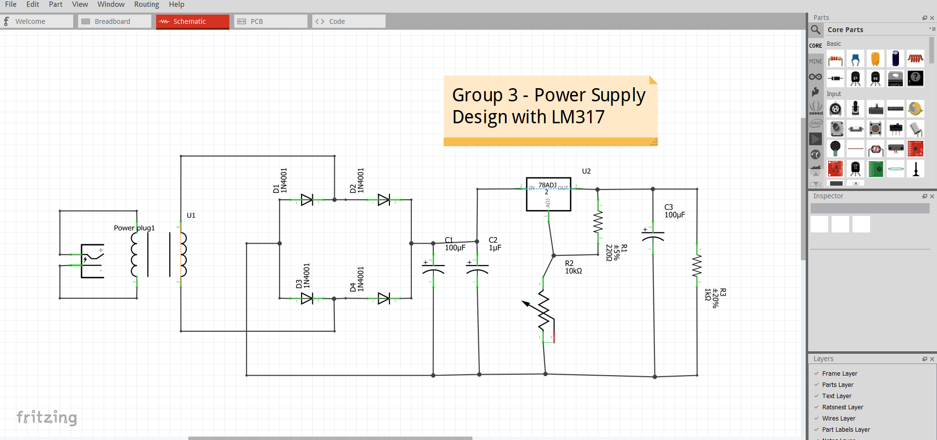
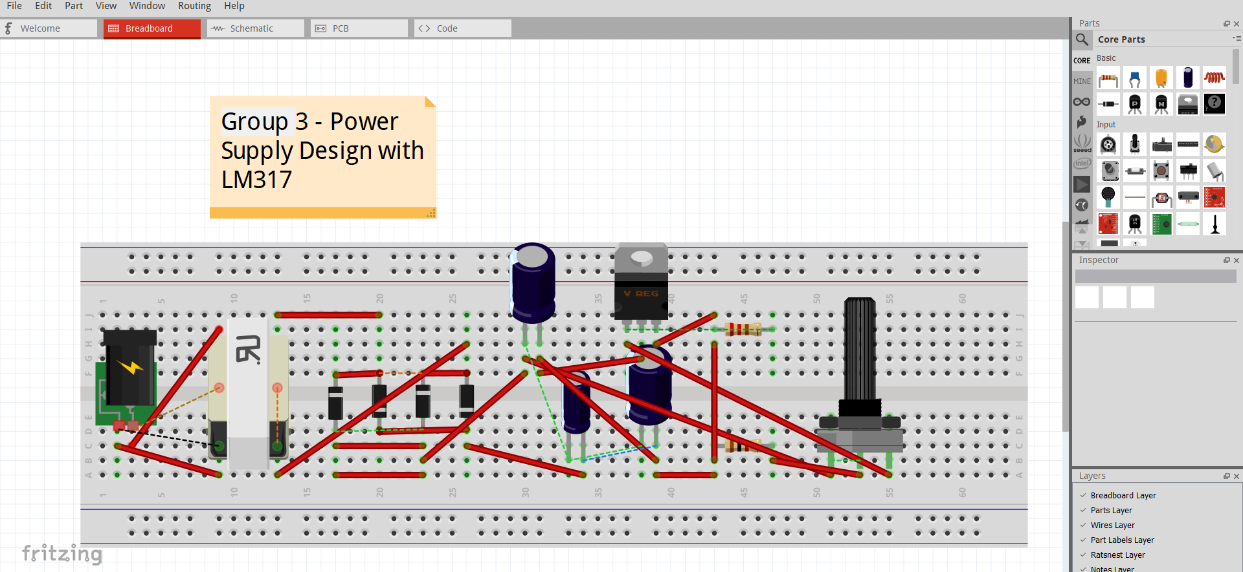
Circuit Diagram in Fritzing

Slide 5
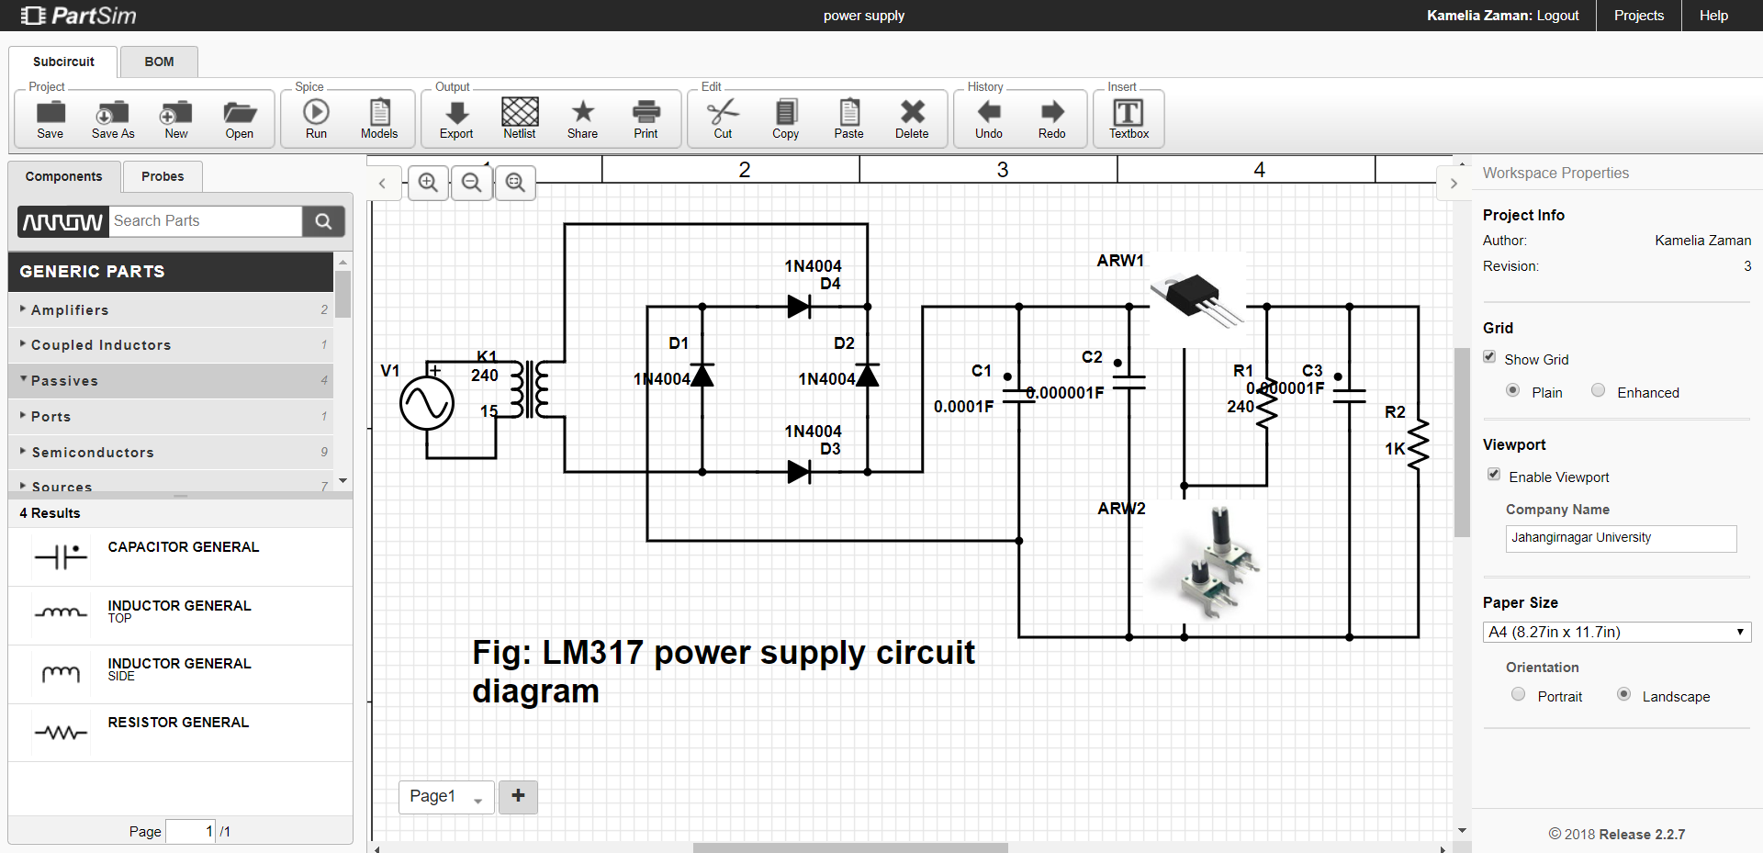
Circuit Diagram in Partsim

Slide 6
Bill of Material
4 units of 1N4001 diode
2 units of 100µF electrolytic capacitor
1 unit of 1µF electrolytic capacitor
1 unit of 1kΩ resistor
1 unit of 240Ω ±5% resistor
1 unit of 10kΩ potentiometer
1 unit of LM317 adjustable regulator IC
1 unit of 220/12Vrms, 0.75A transformer
1 unit of light emitting diode
1 unit of heat sinker
1 unit of breadboard
1unit of power plug
Connecting wires

Slide 7
Working Procedure
Discussion of the Project:
A power supply circuit produces an direct current (DC) voltage out from alternating current (AC) voltage. Common application of power supply circuit is to provide constant and stable voltages to electronic devices. Basically, power supply circuit has five stages or blocks. They are transformer, rectifier, filter/smoothing, regulator and the load.

Slide 8
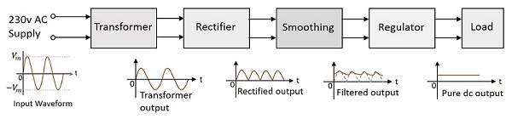
Working Procedure
Transformer - used to step down the voltage from 220Vrms to 12Vrms or any desired voltage. Lowering the voltage is necessary because application of DC voltage is usually at lower voltage.
Rectifier - used to convert AC to pulsating DC.
Filter/Smoothing - removes the pulsation to the DC voltage and smoothens the DC output.
Regulator - regulates the output voltage to a specified value.
Load - collects the output voltage

Slide 9
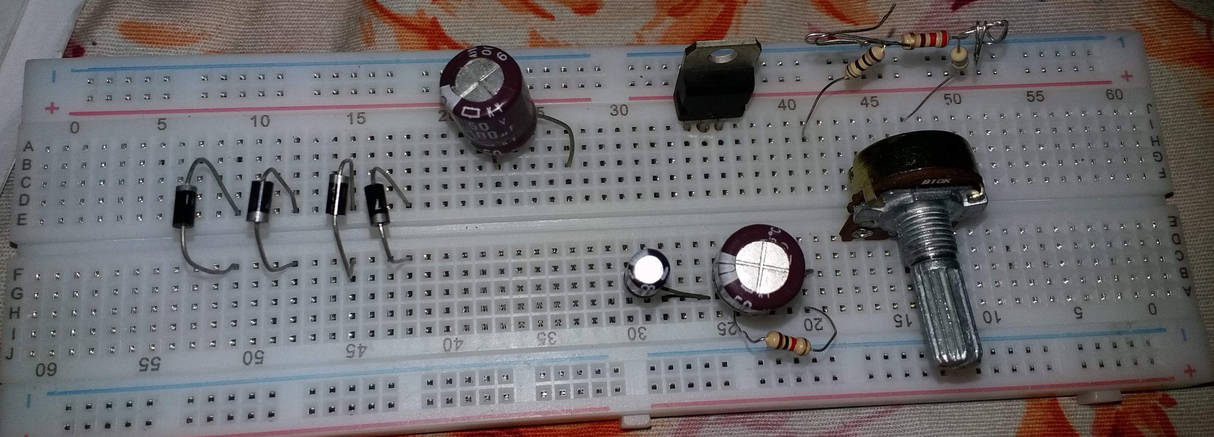
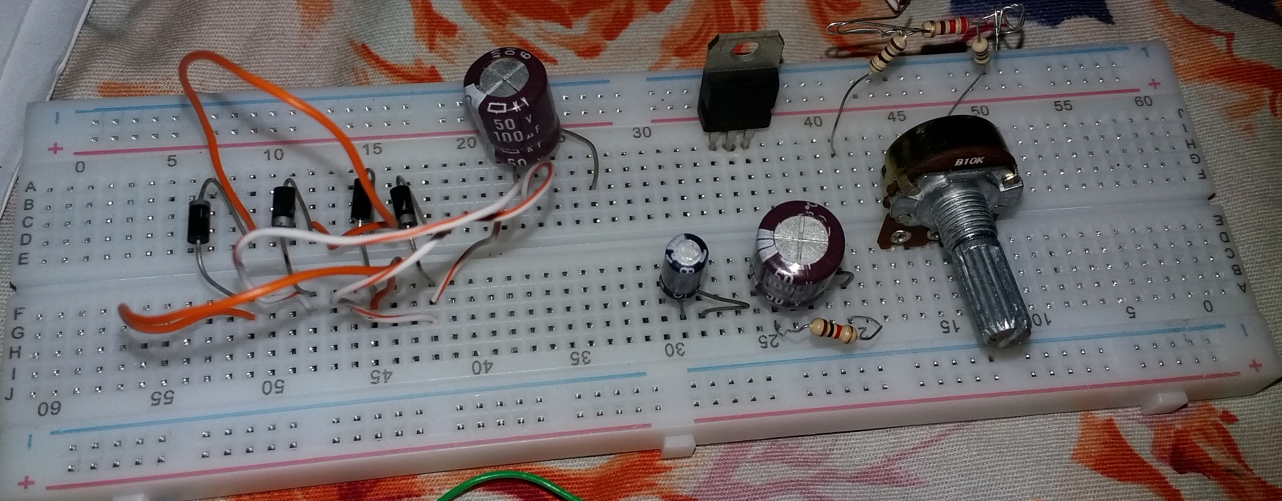
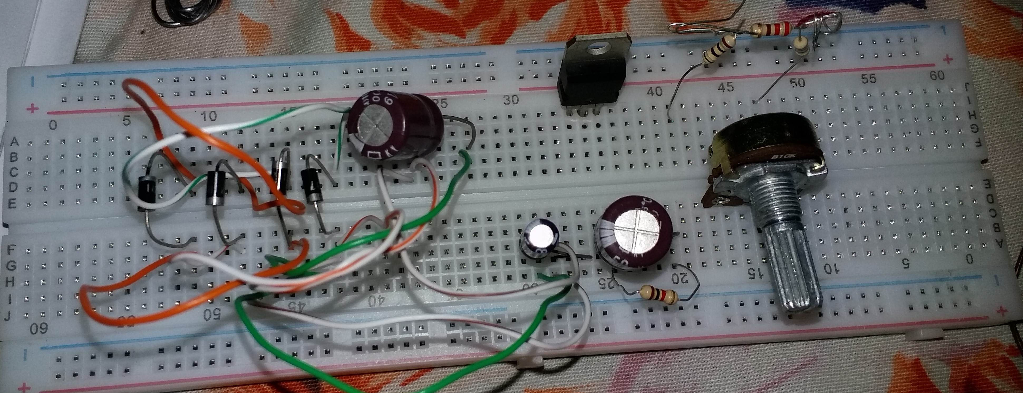
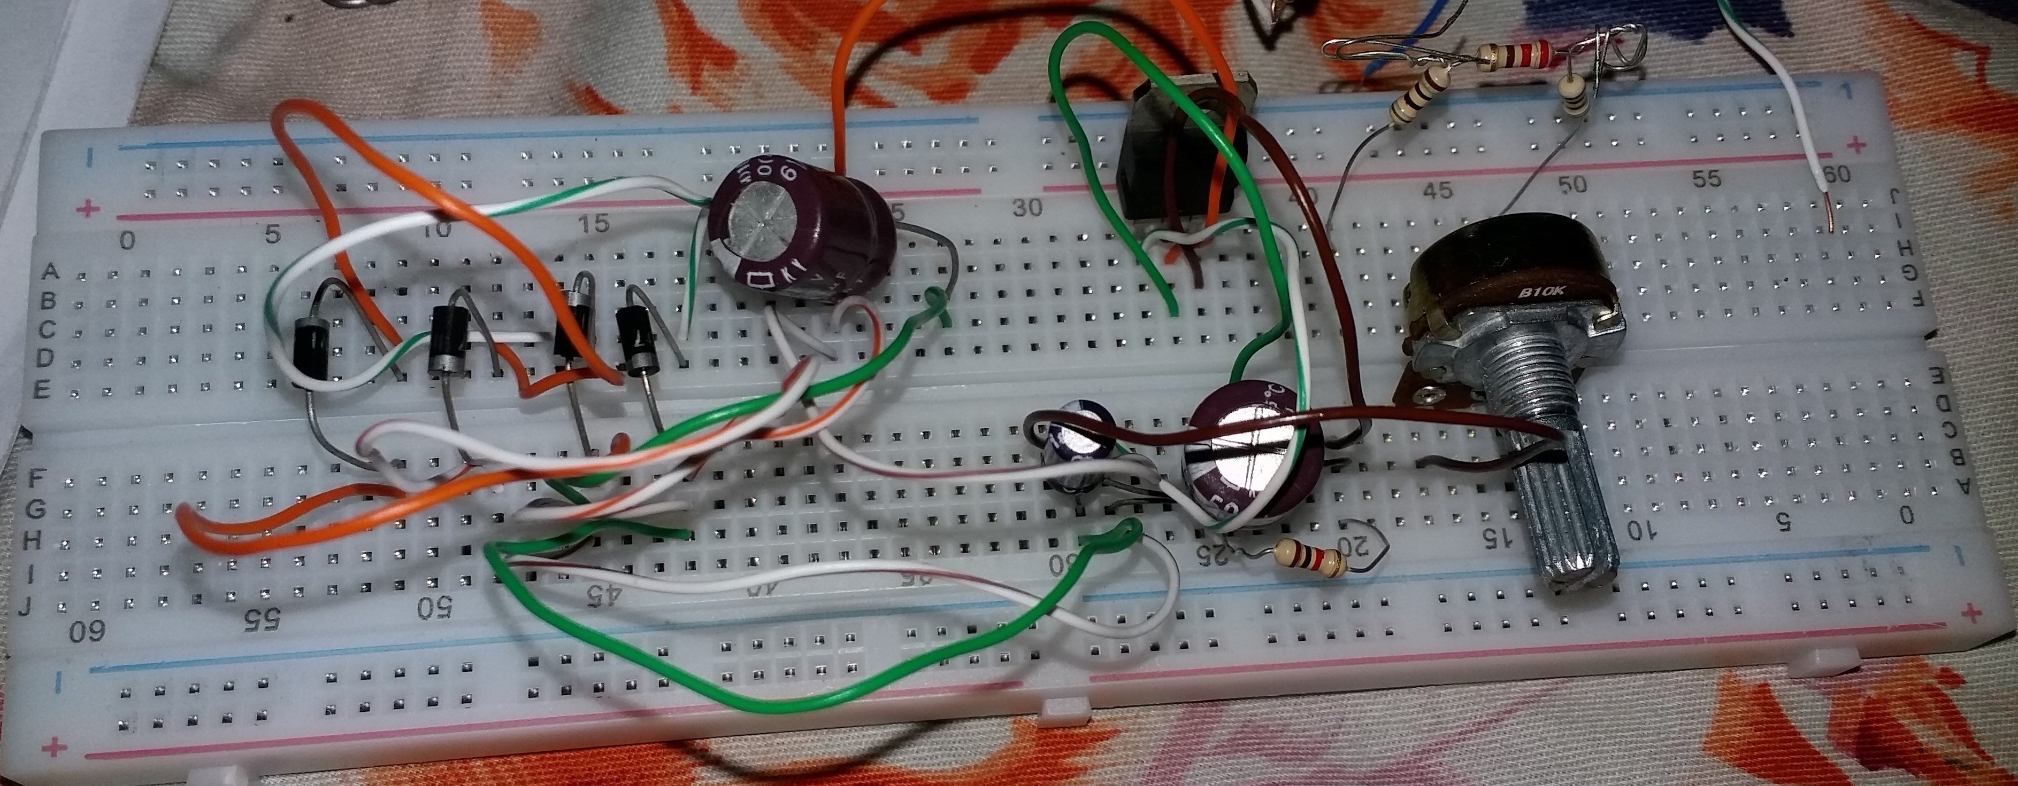
Implementation on Breadboard

Slide 10
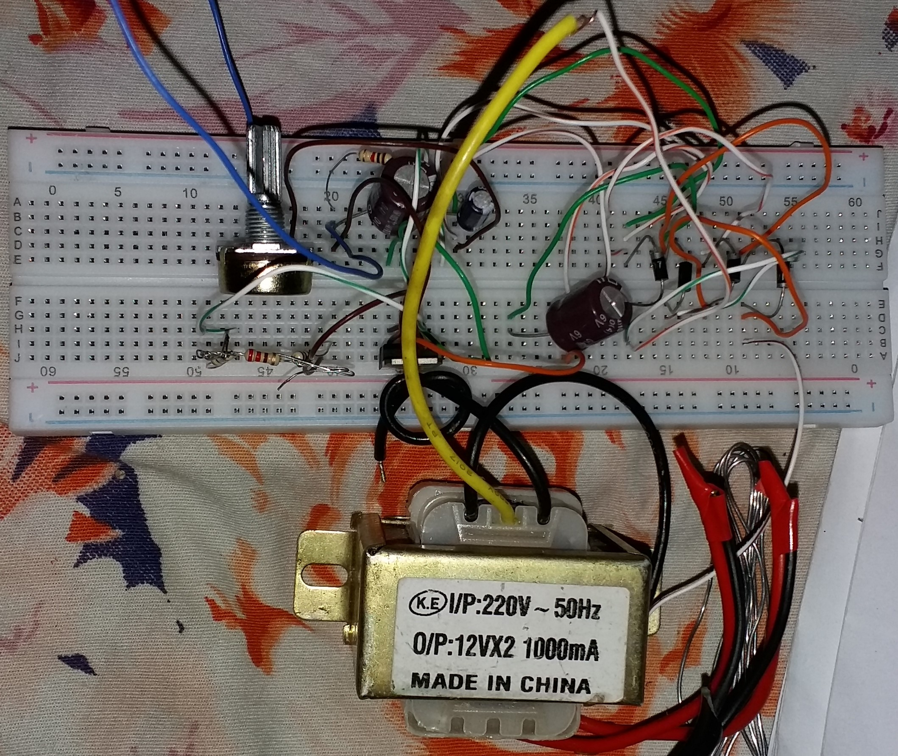
Implementation on Breadboard

Slide 11
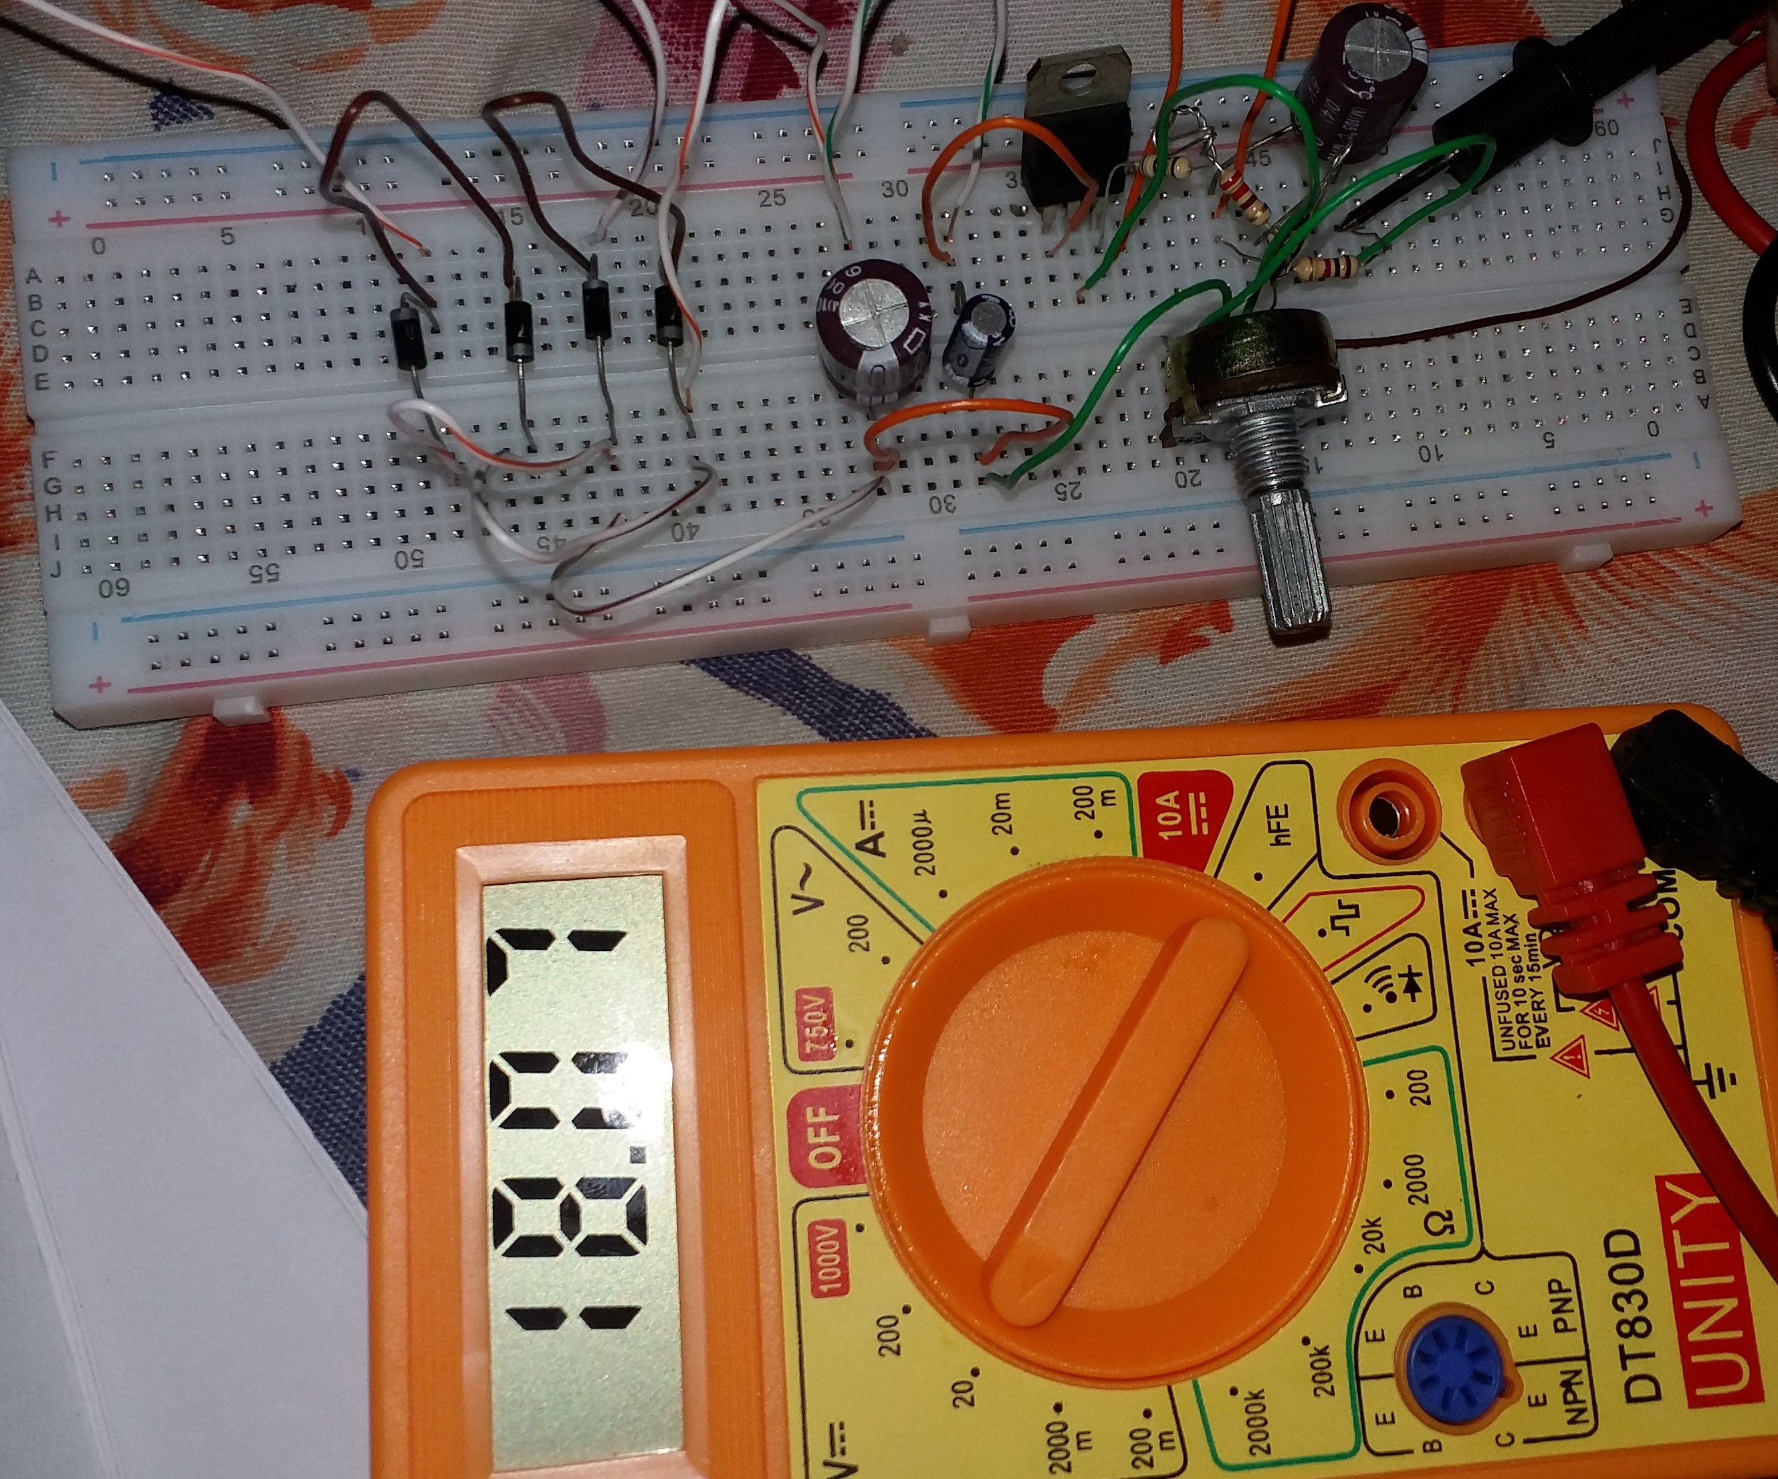
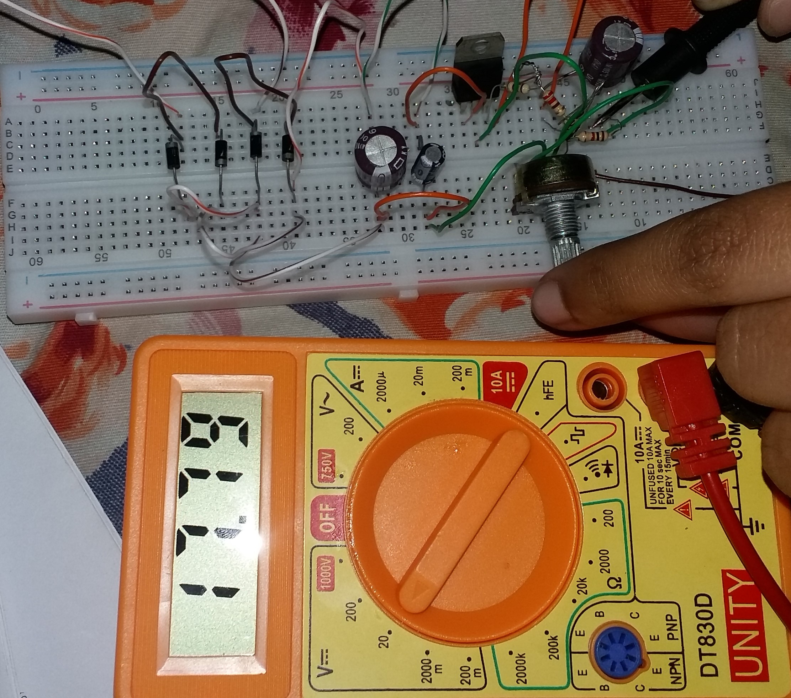
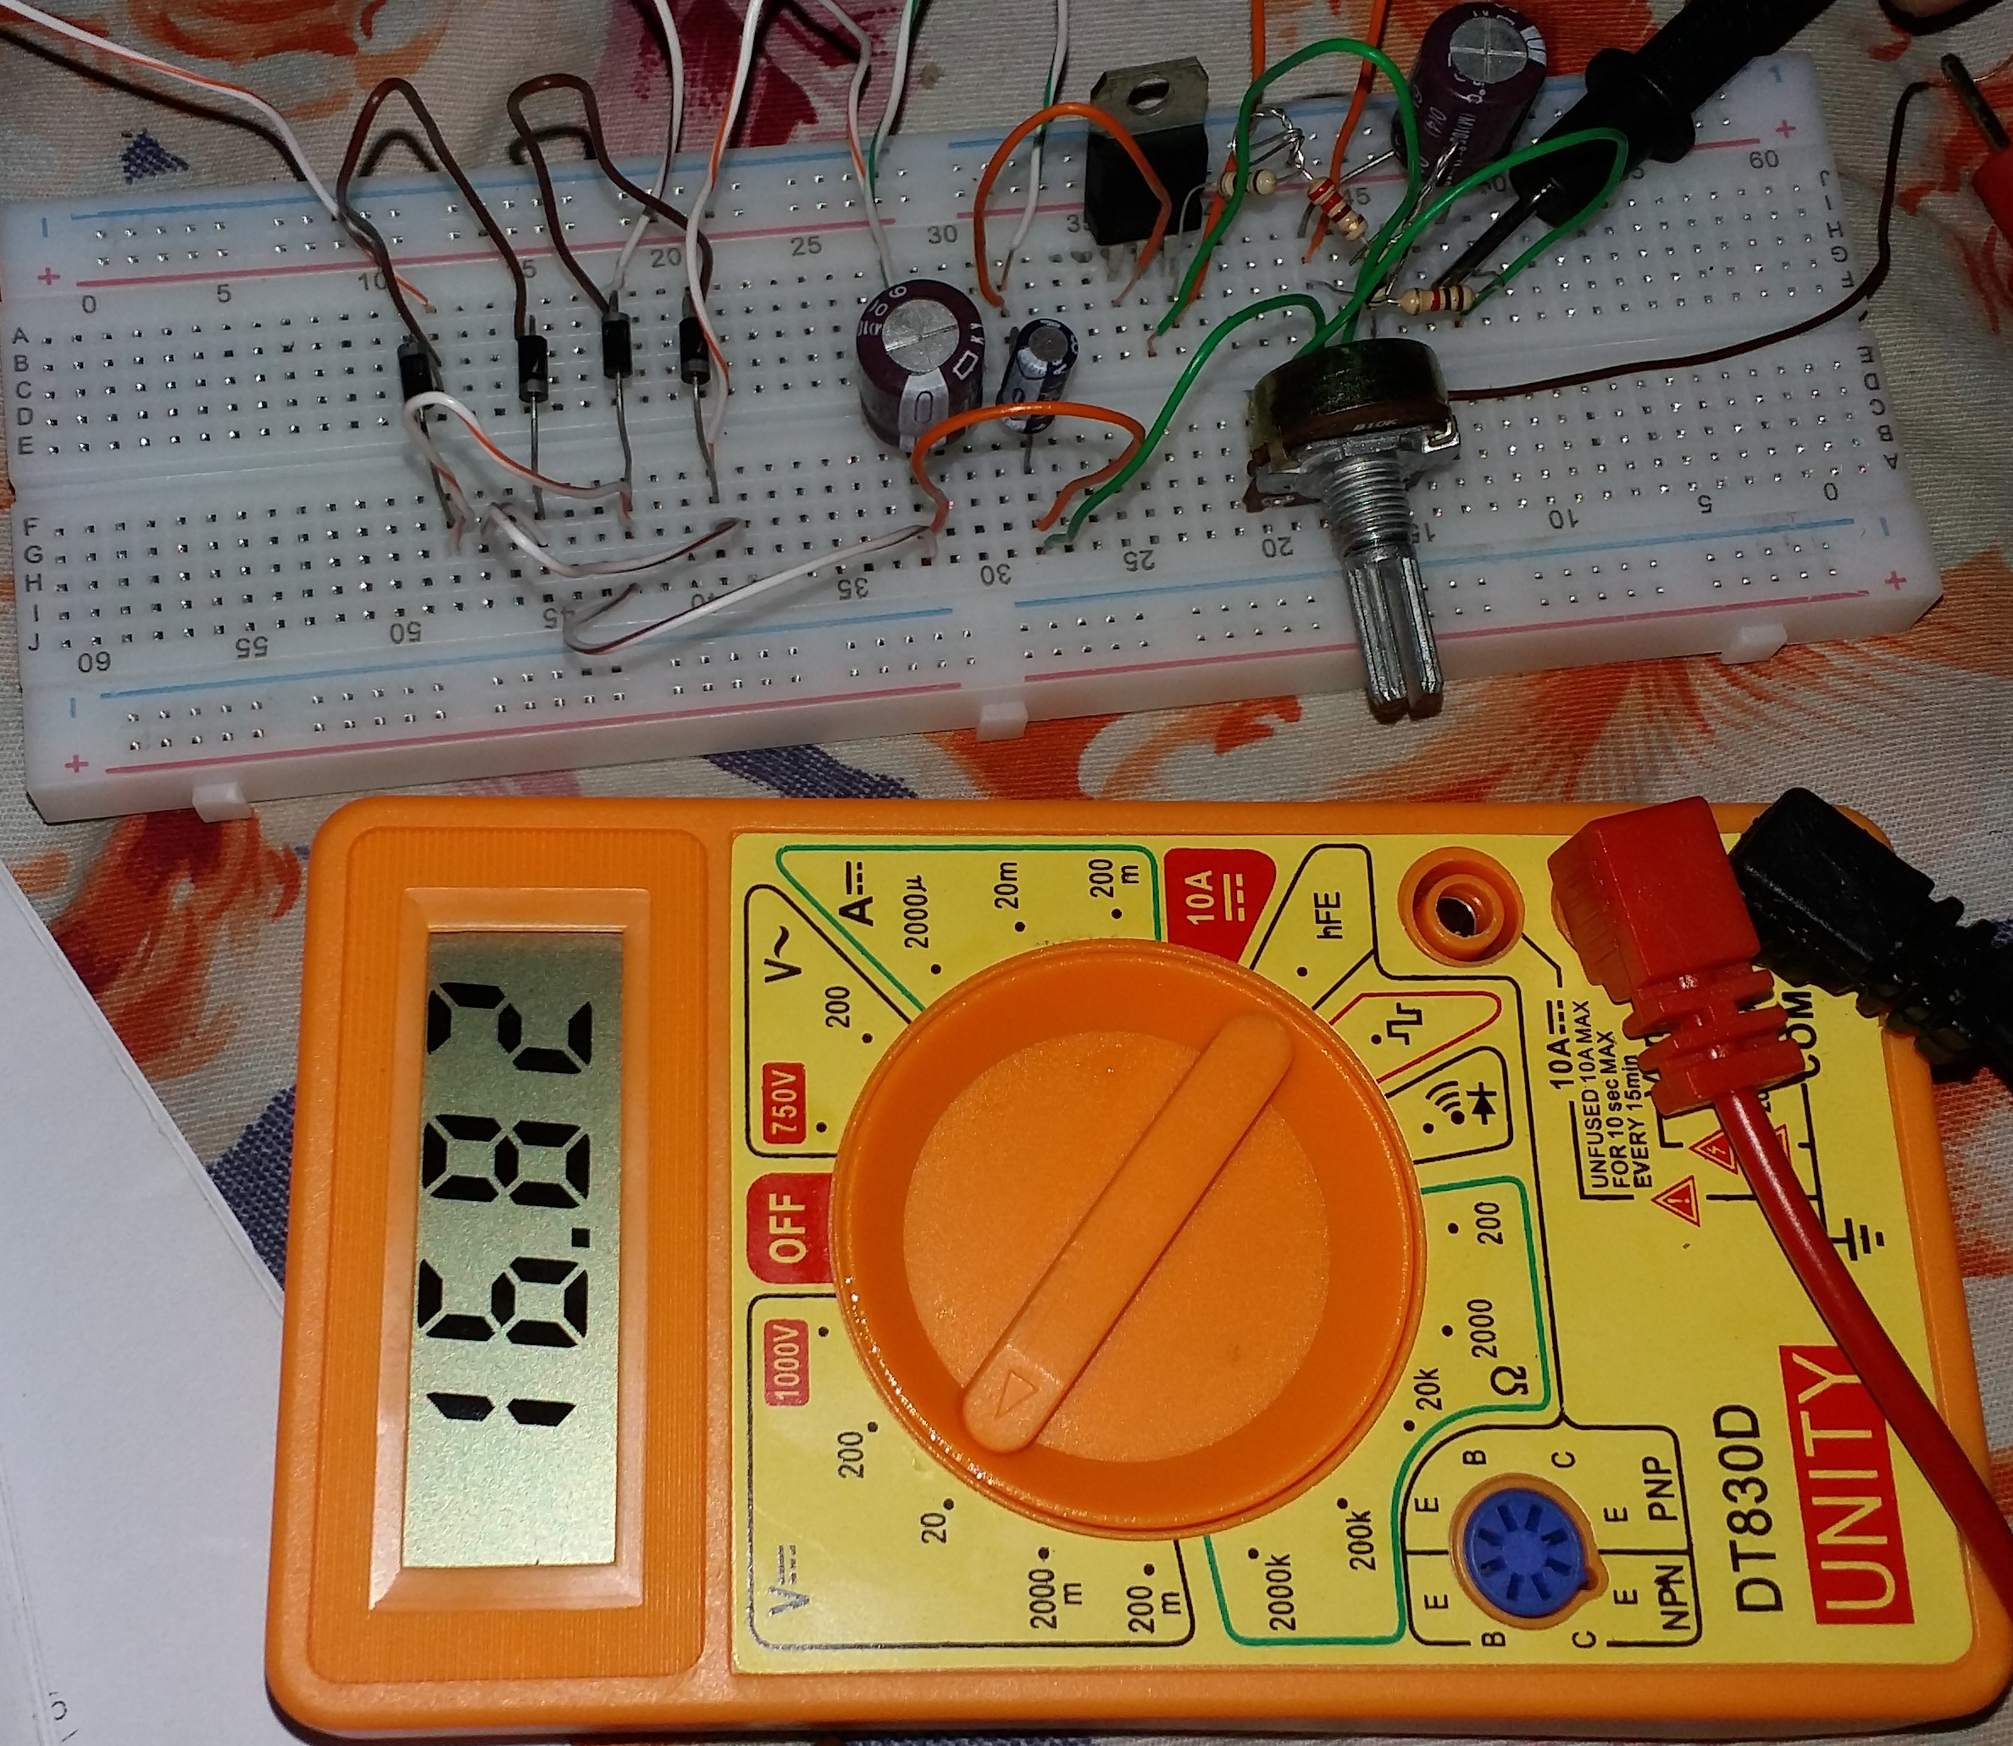
Testing and Results

Slide 12
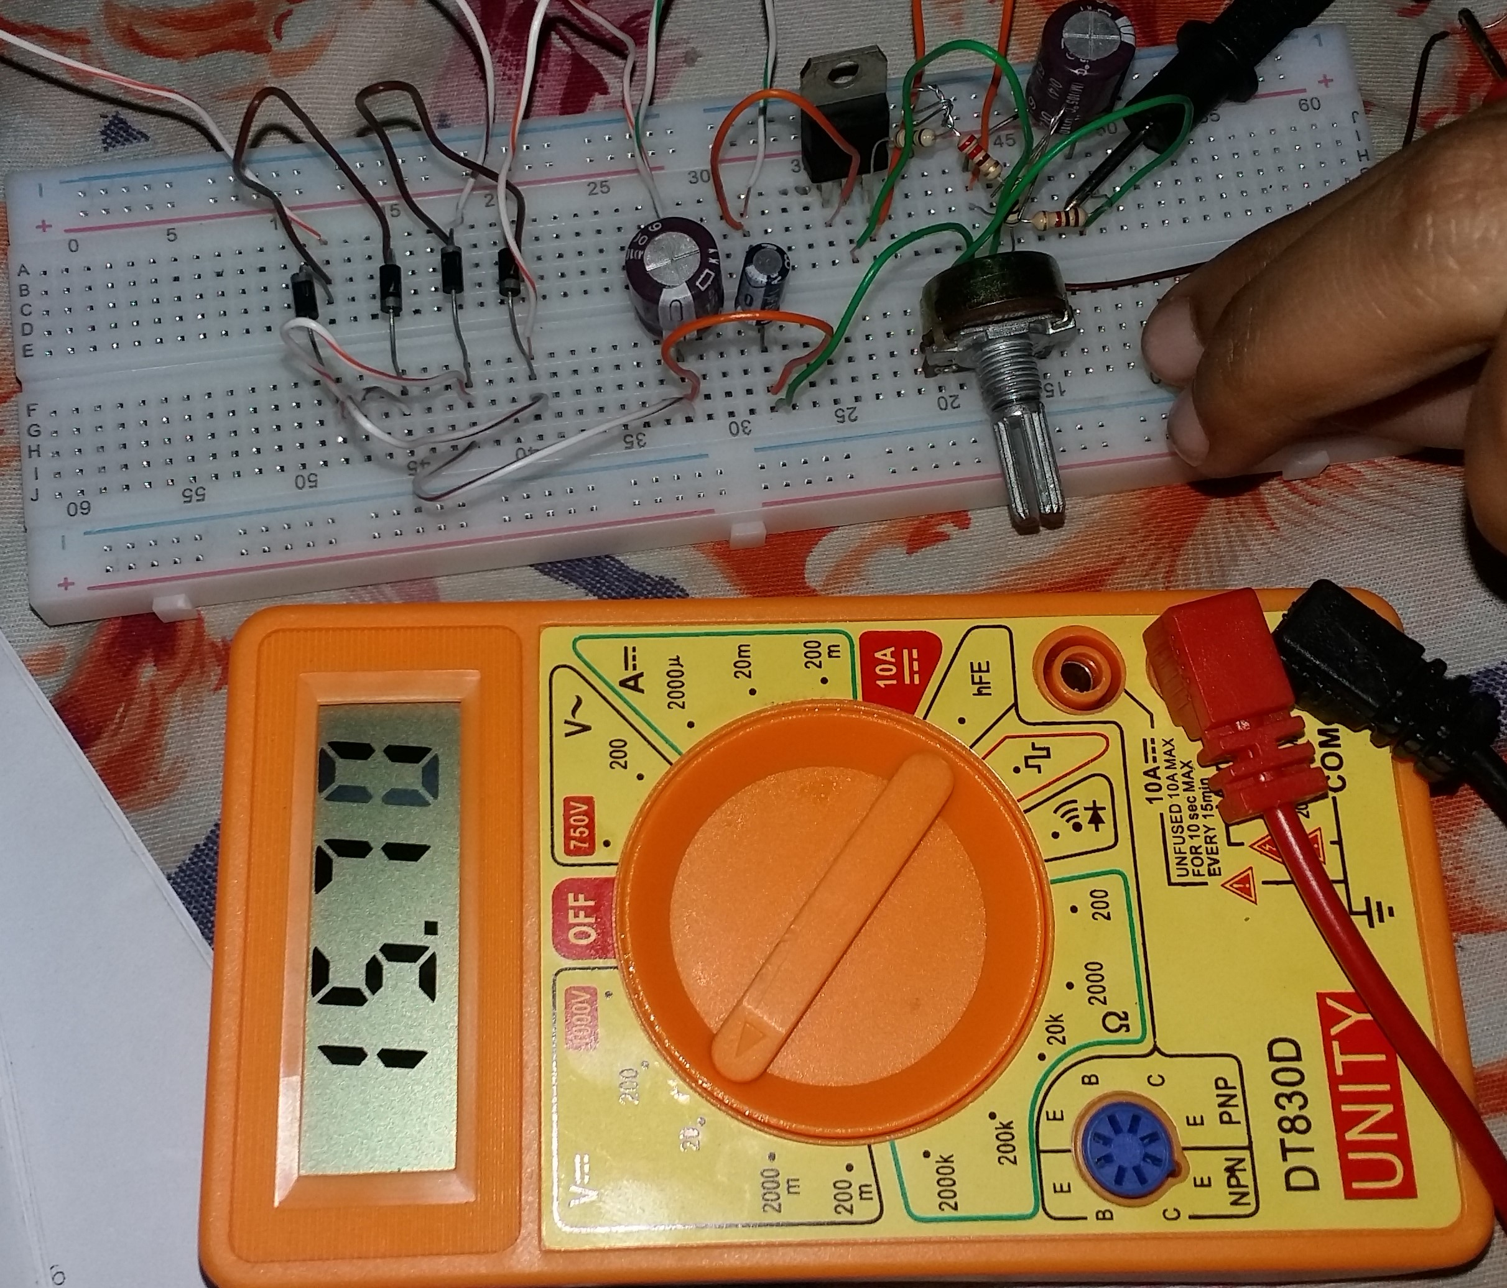
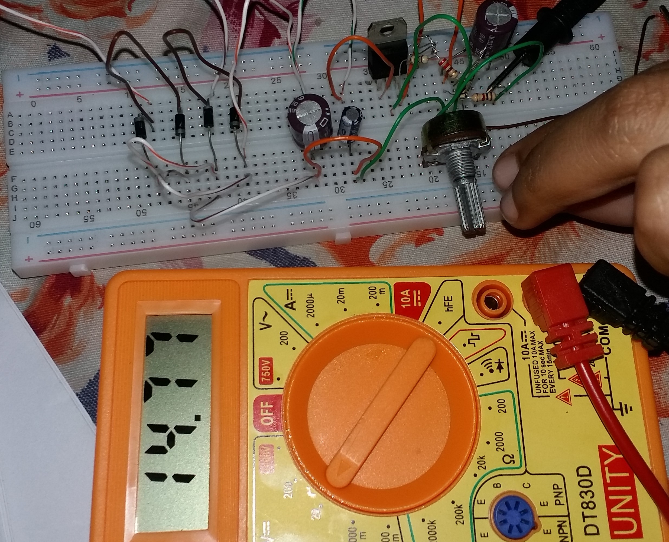
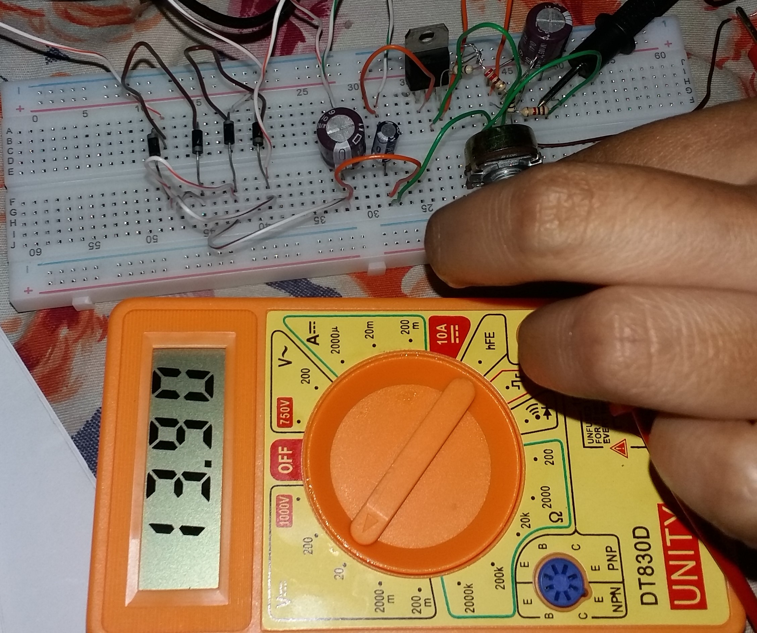
Testing and Results

Slide 13
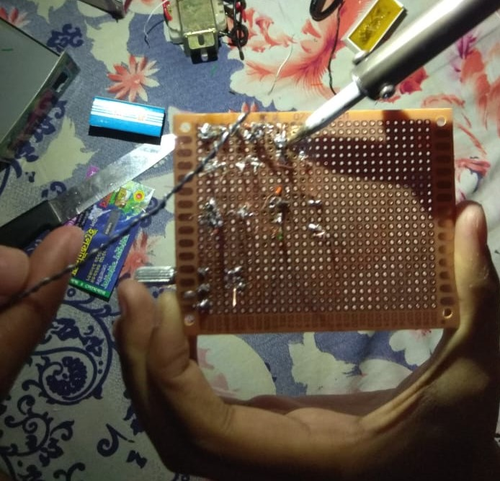
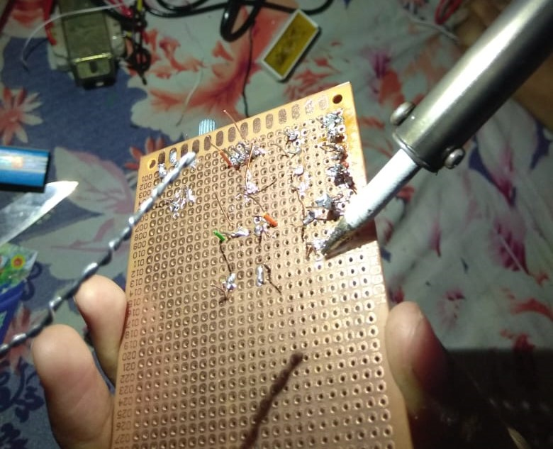
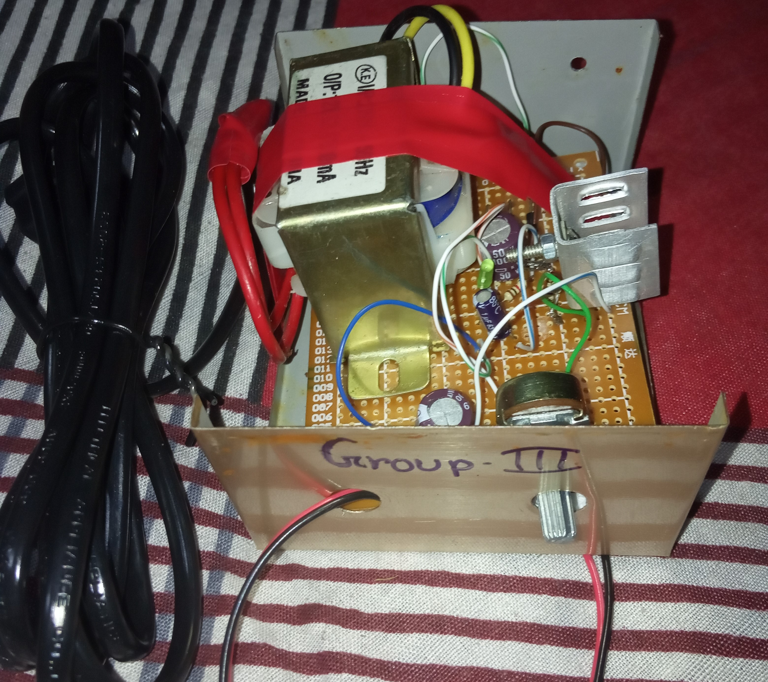
PCB Design and Casing

Slide 14
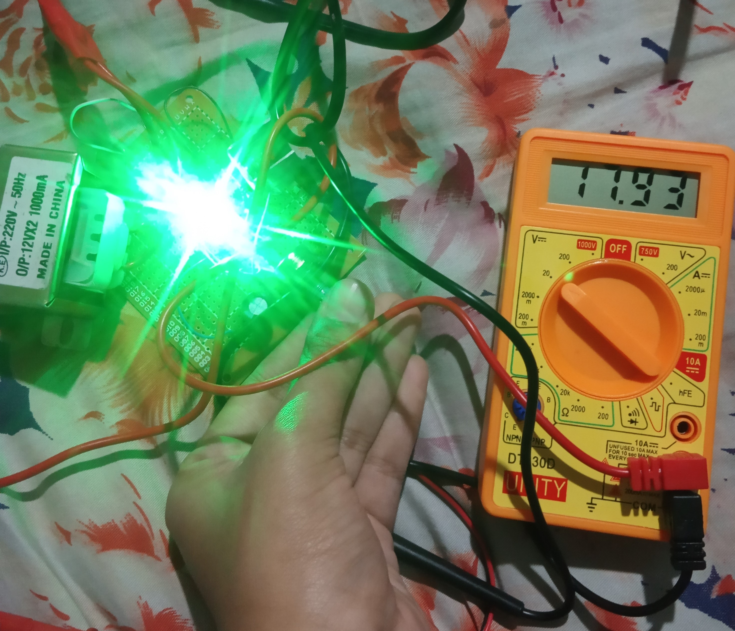
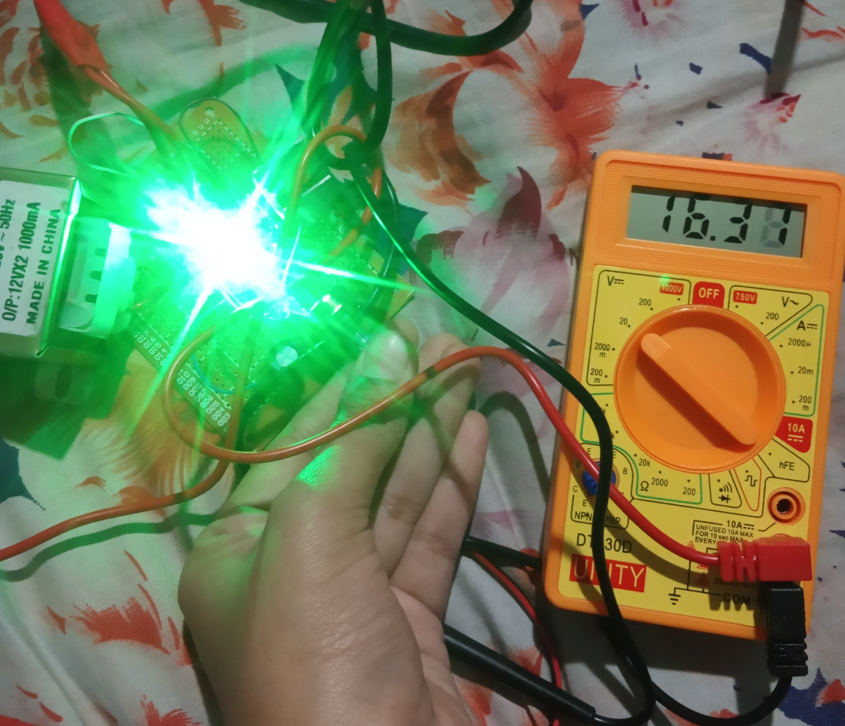
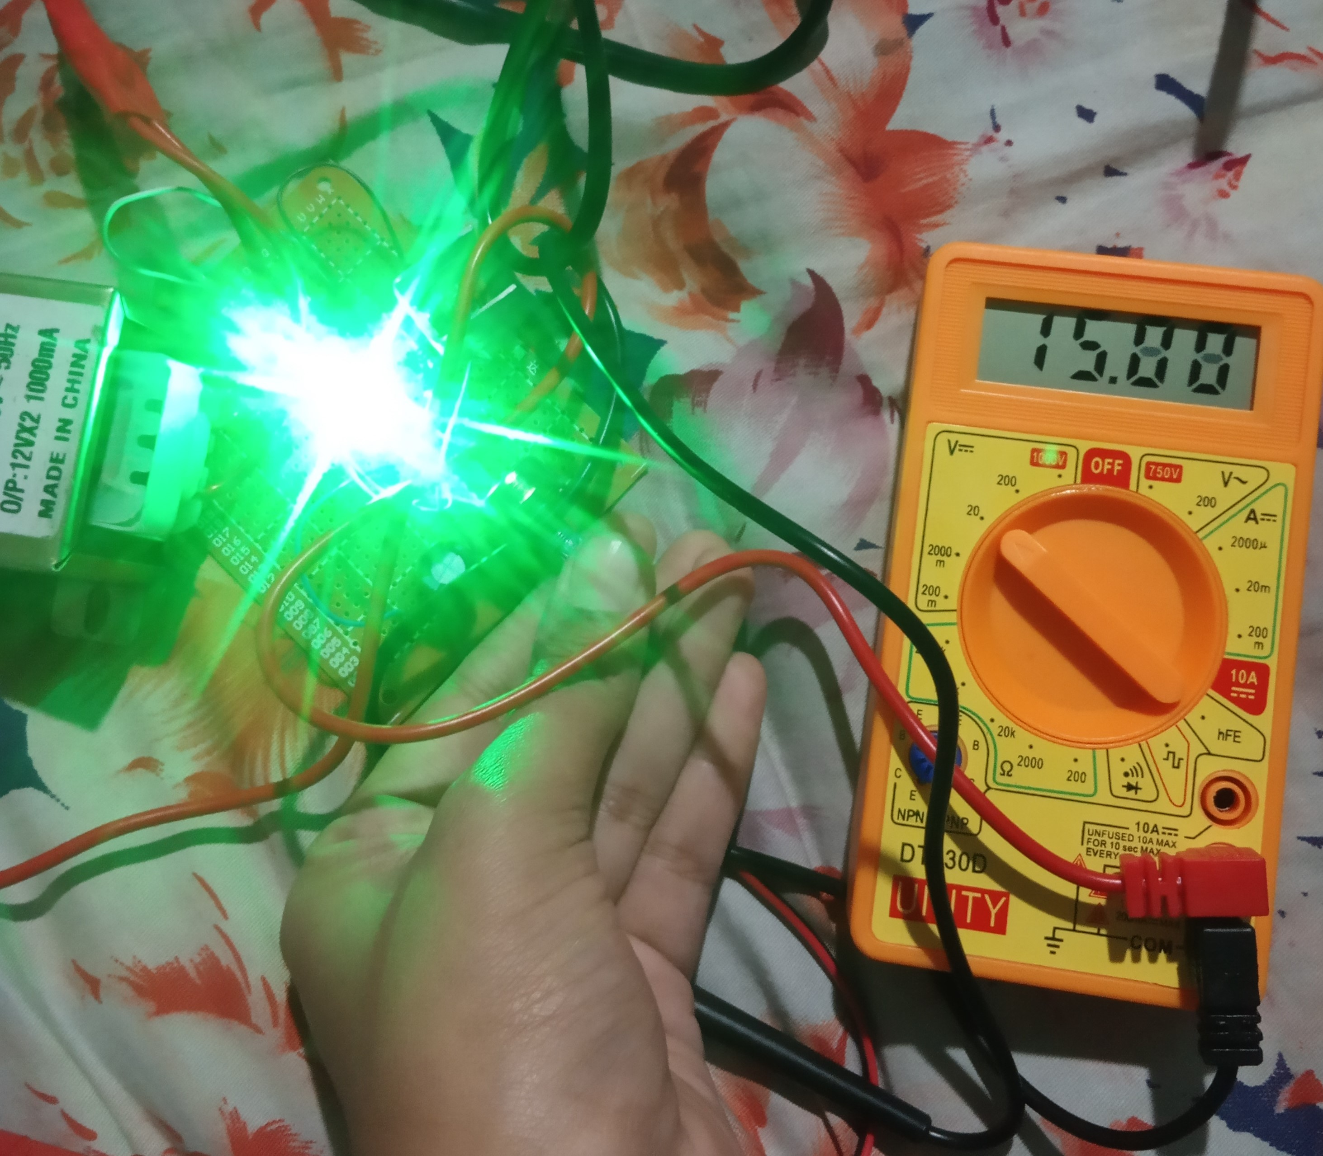
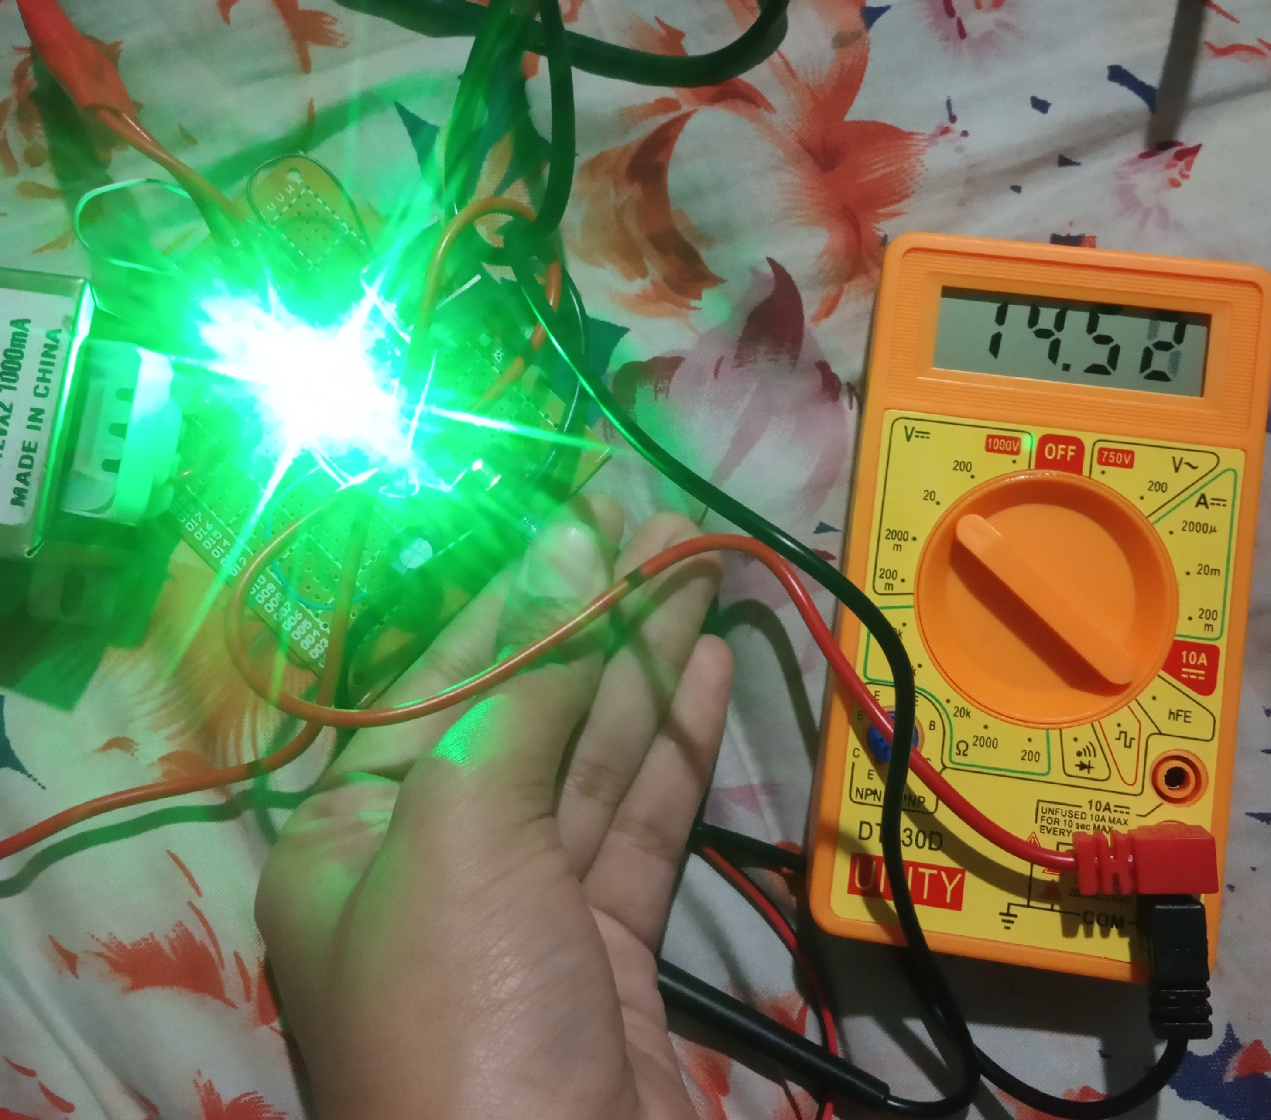
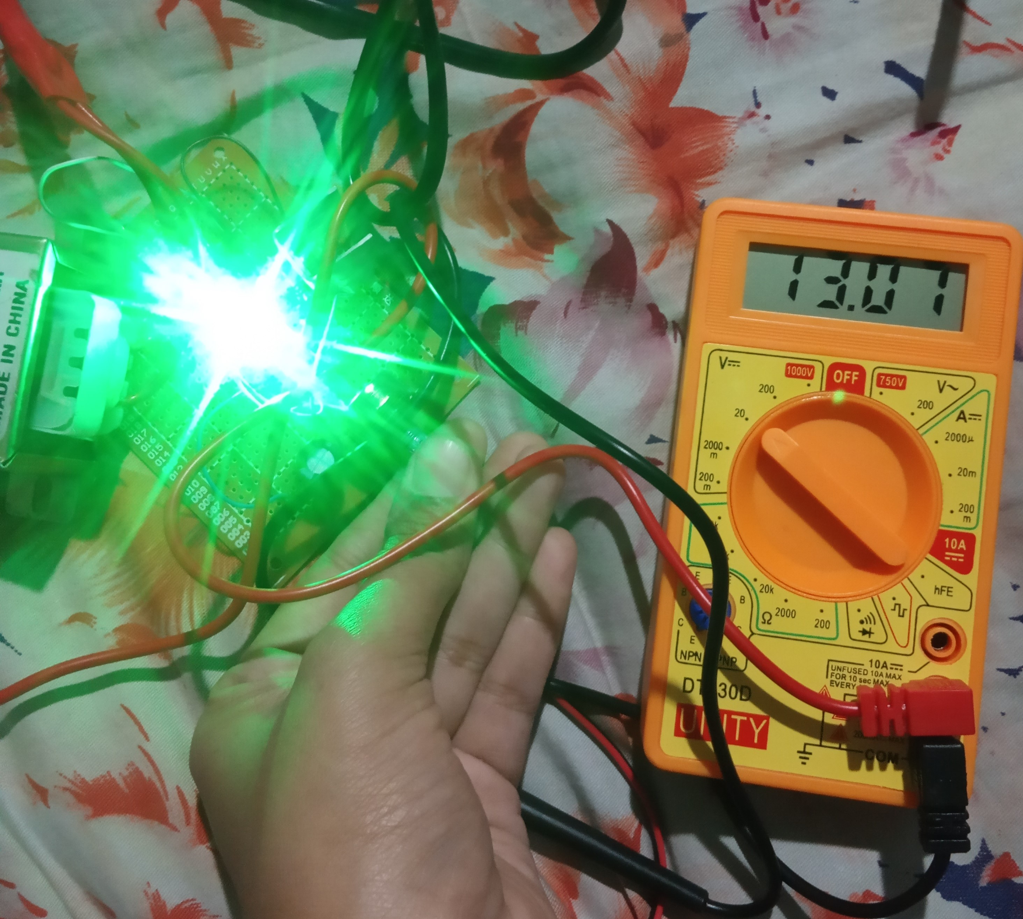
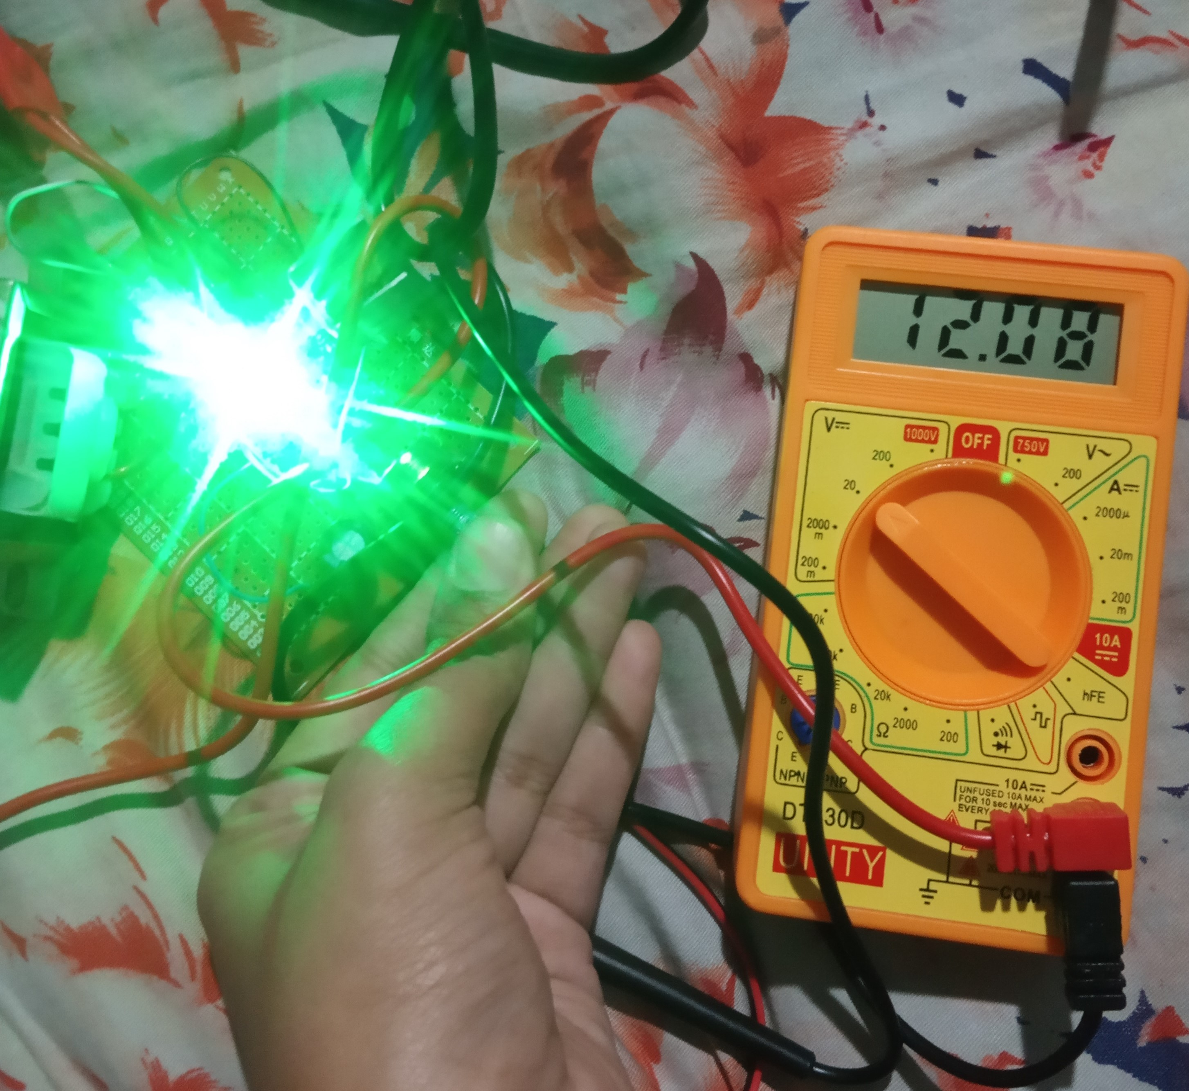
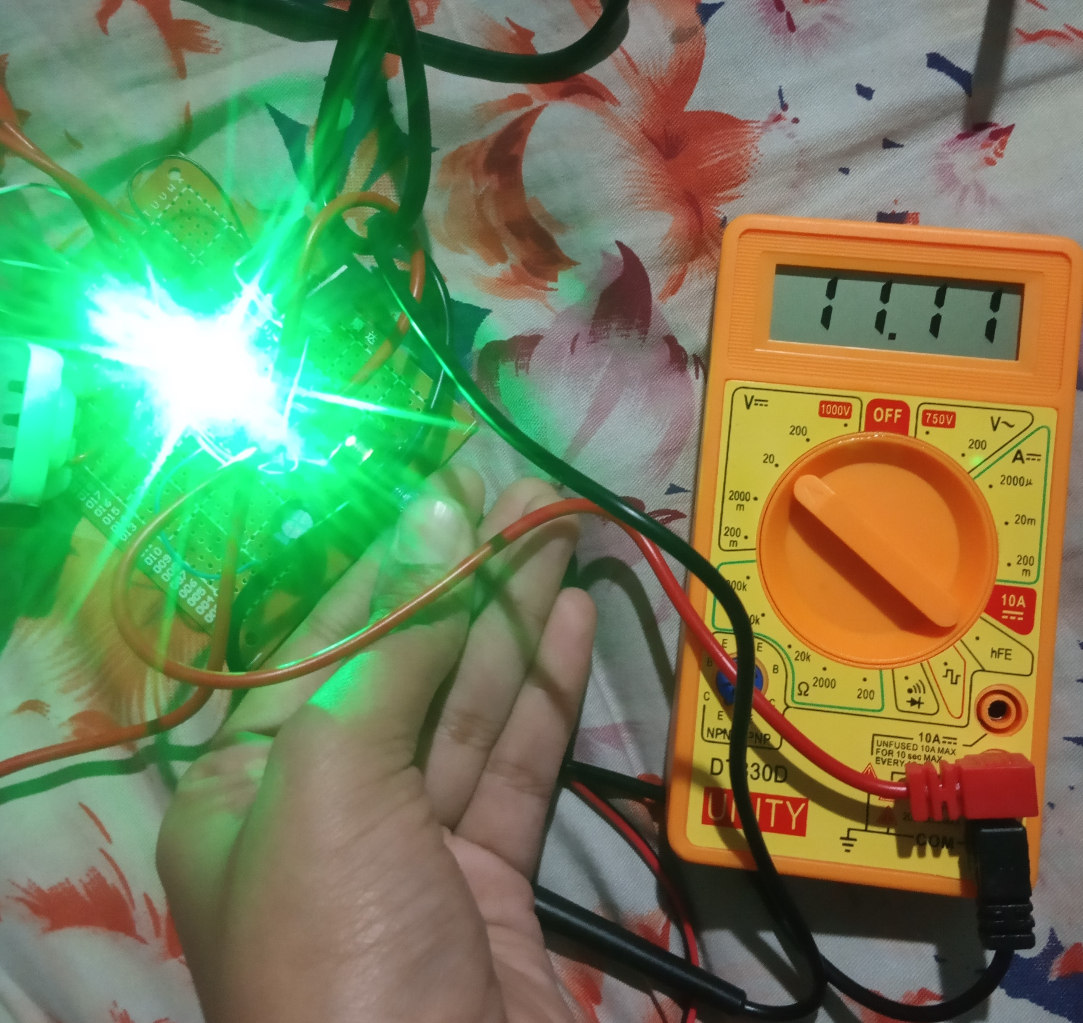
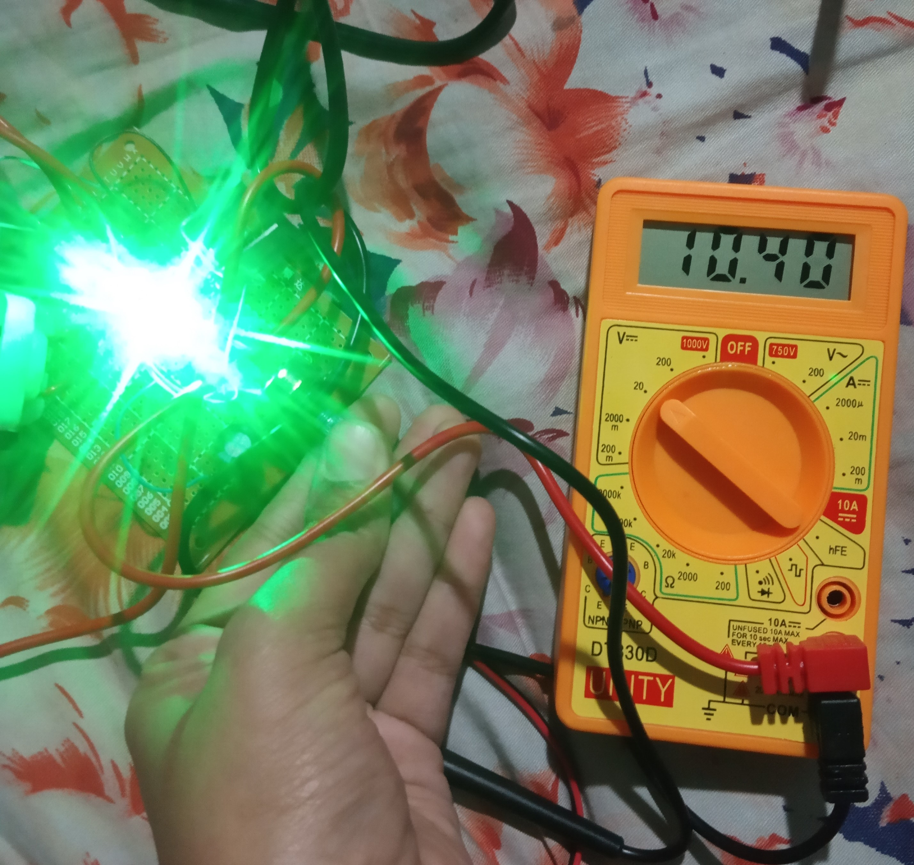
PCB Design and Casing

Slide 15

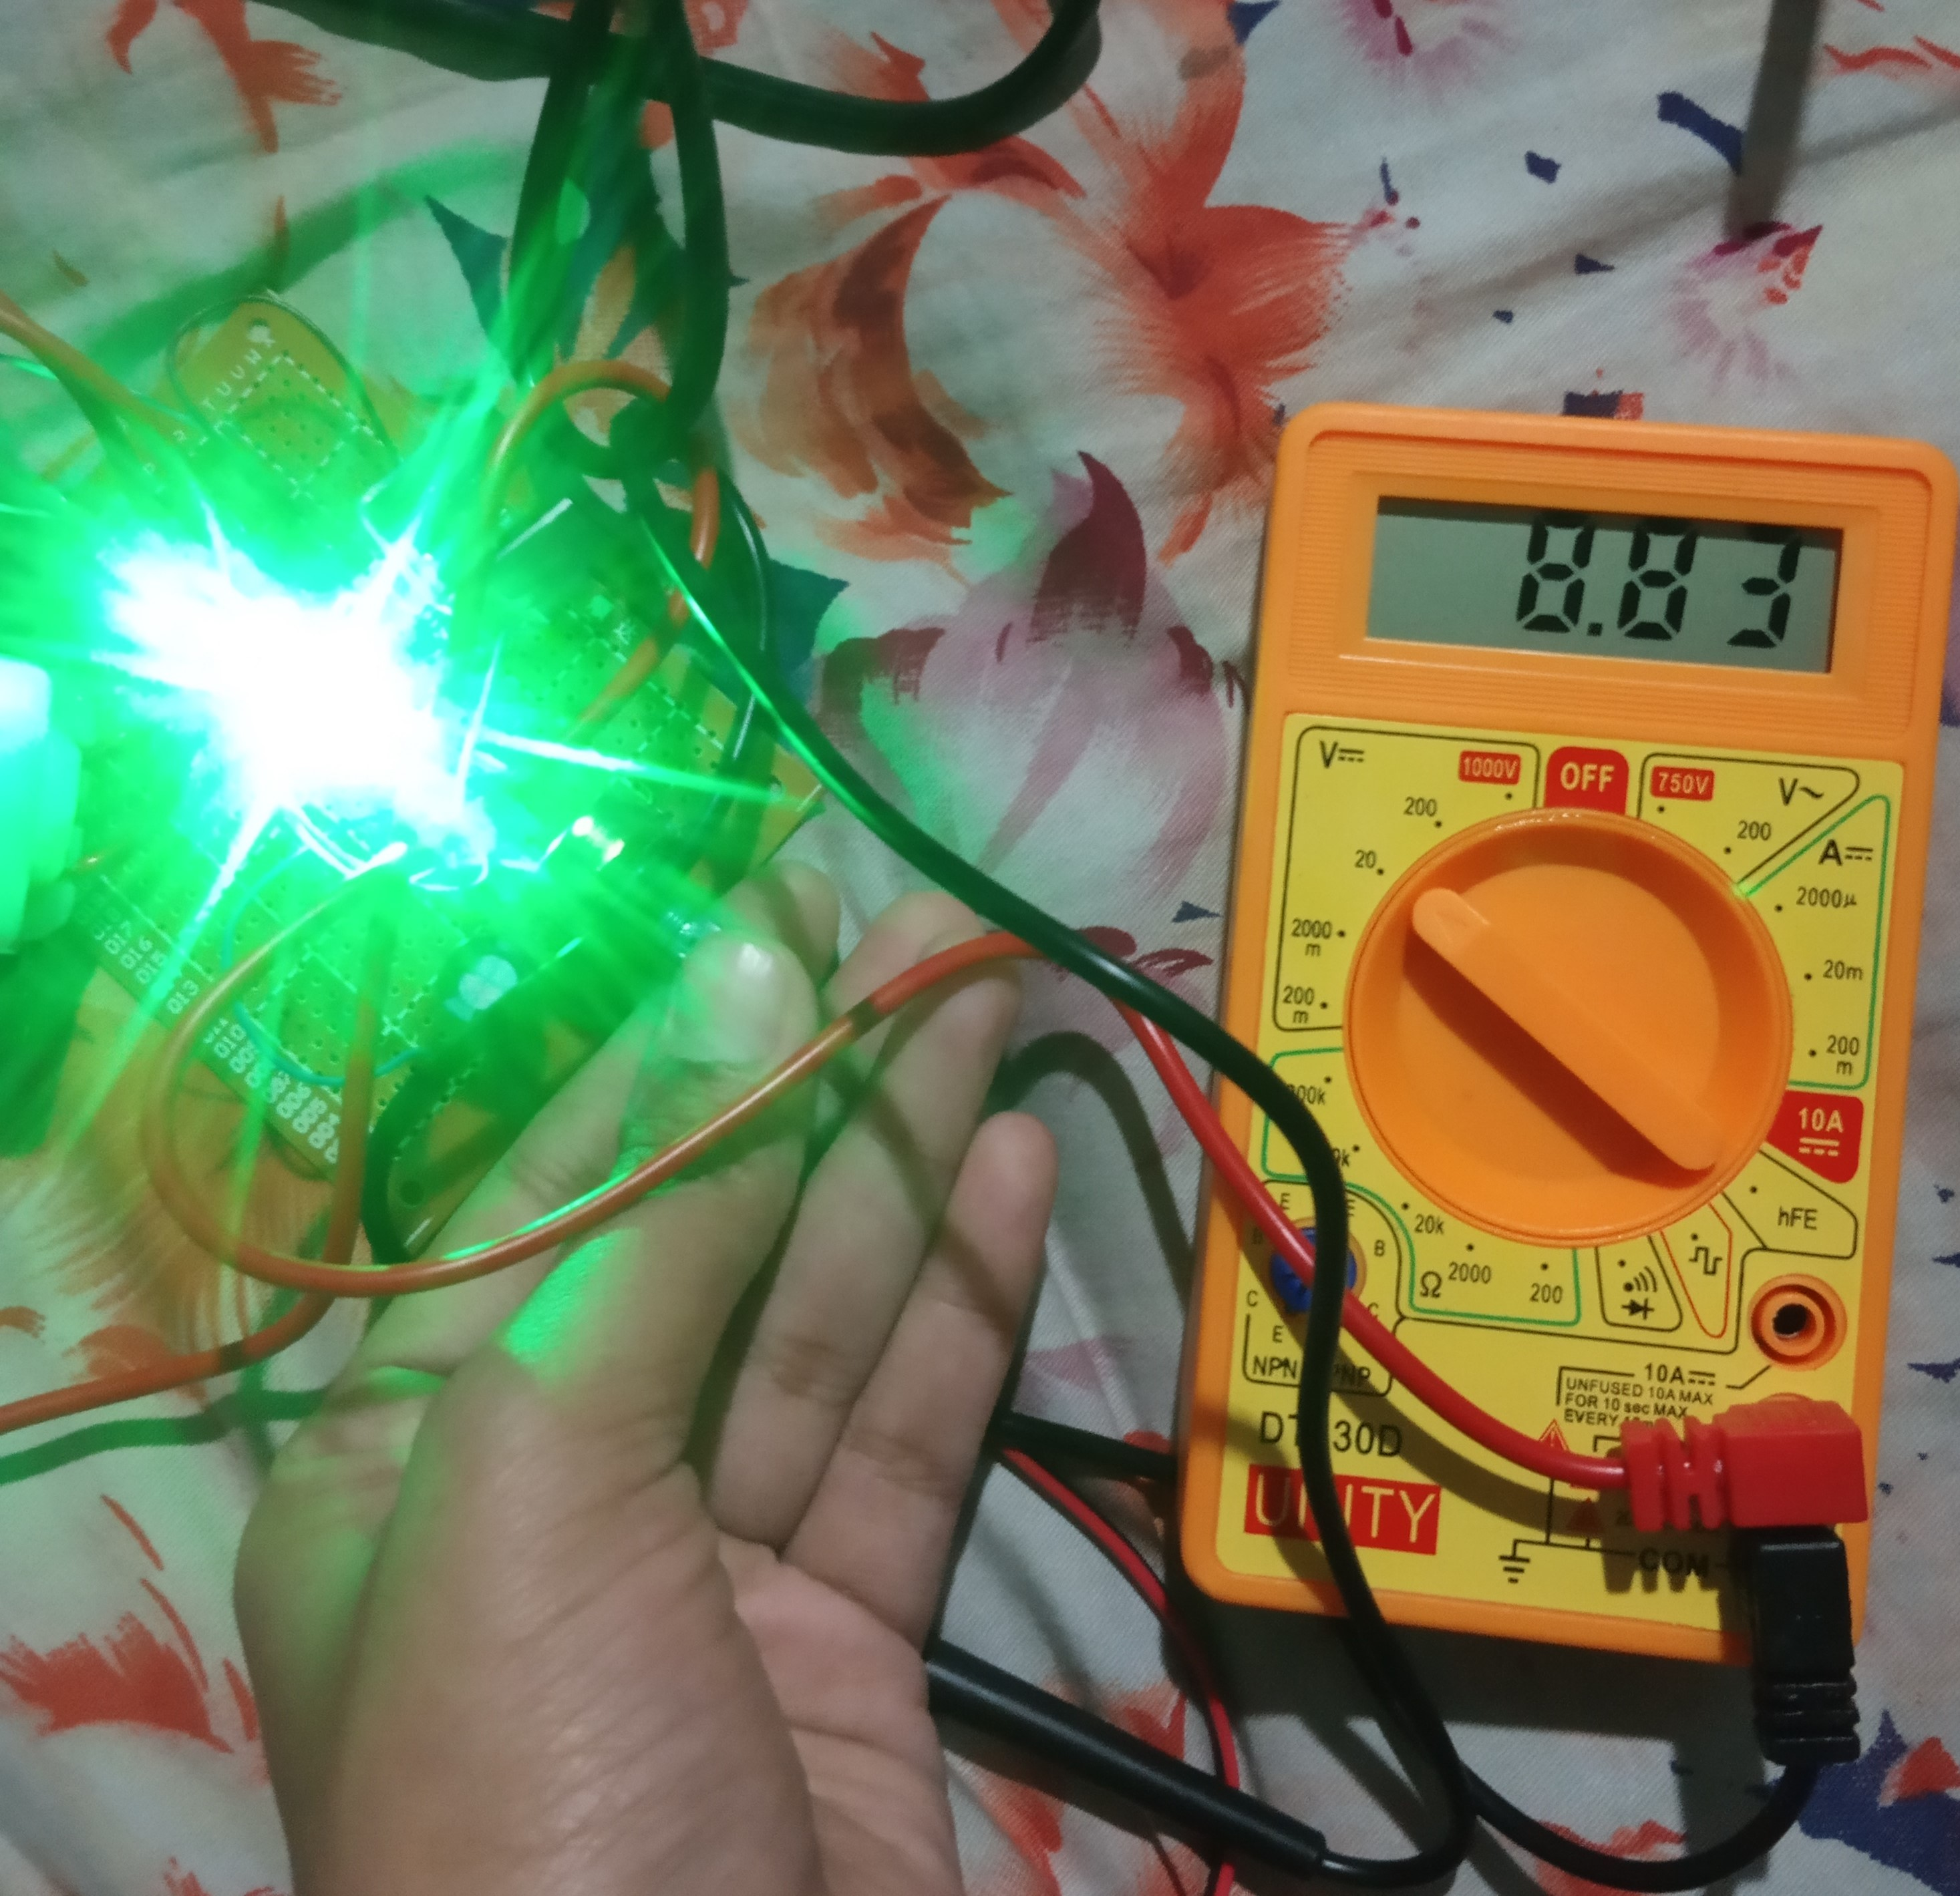
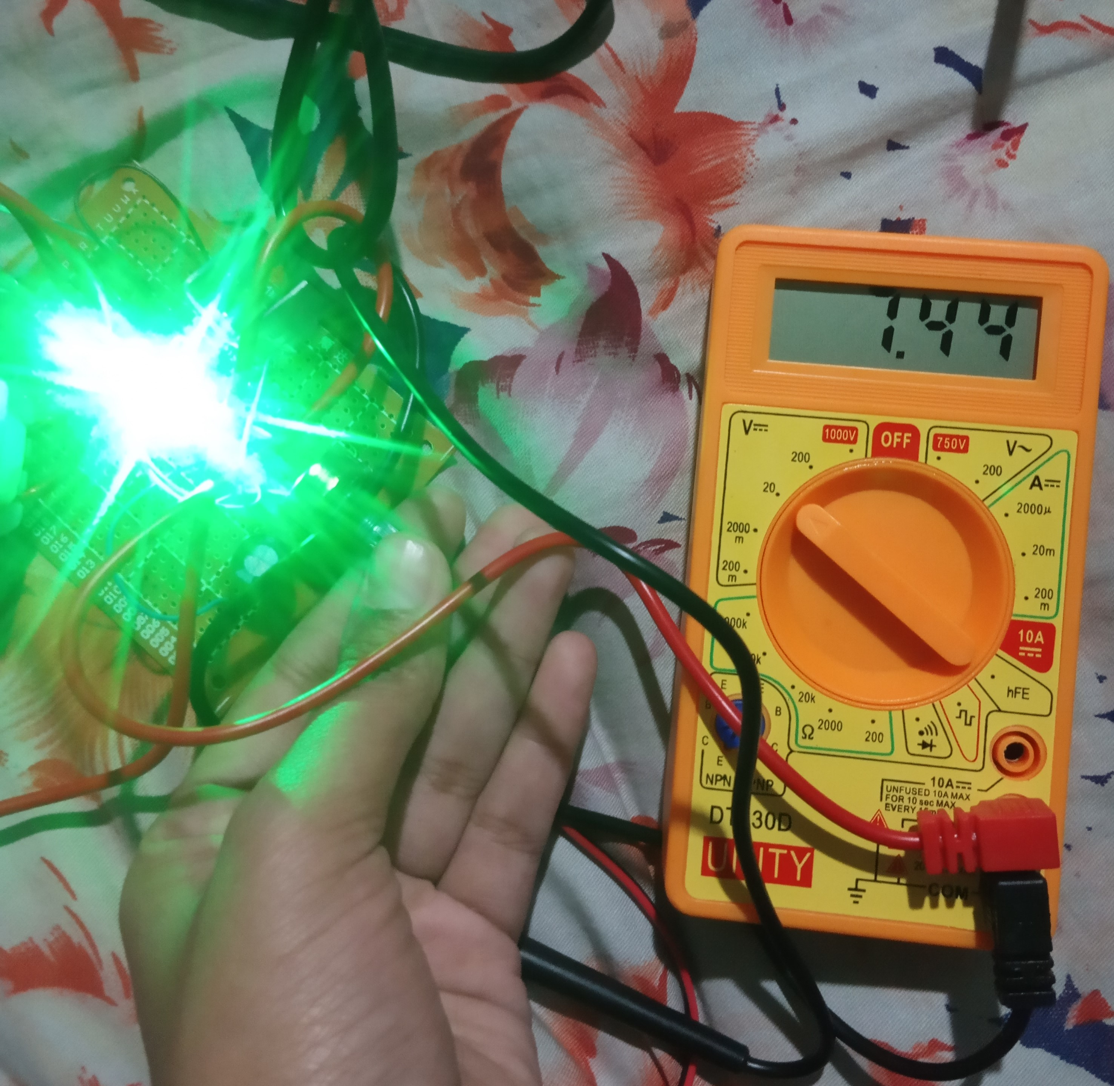
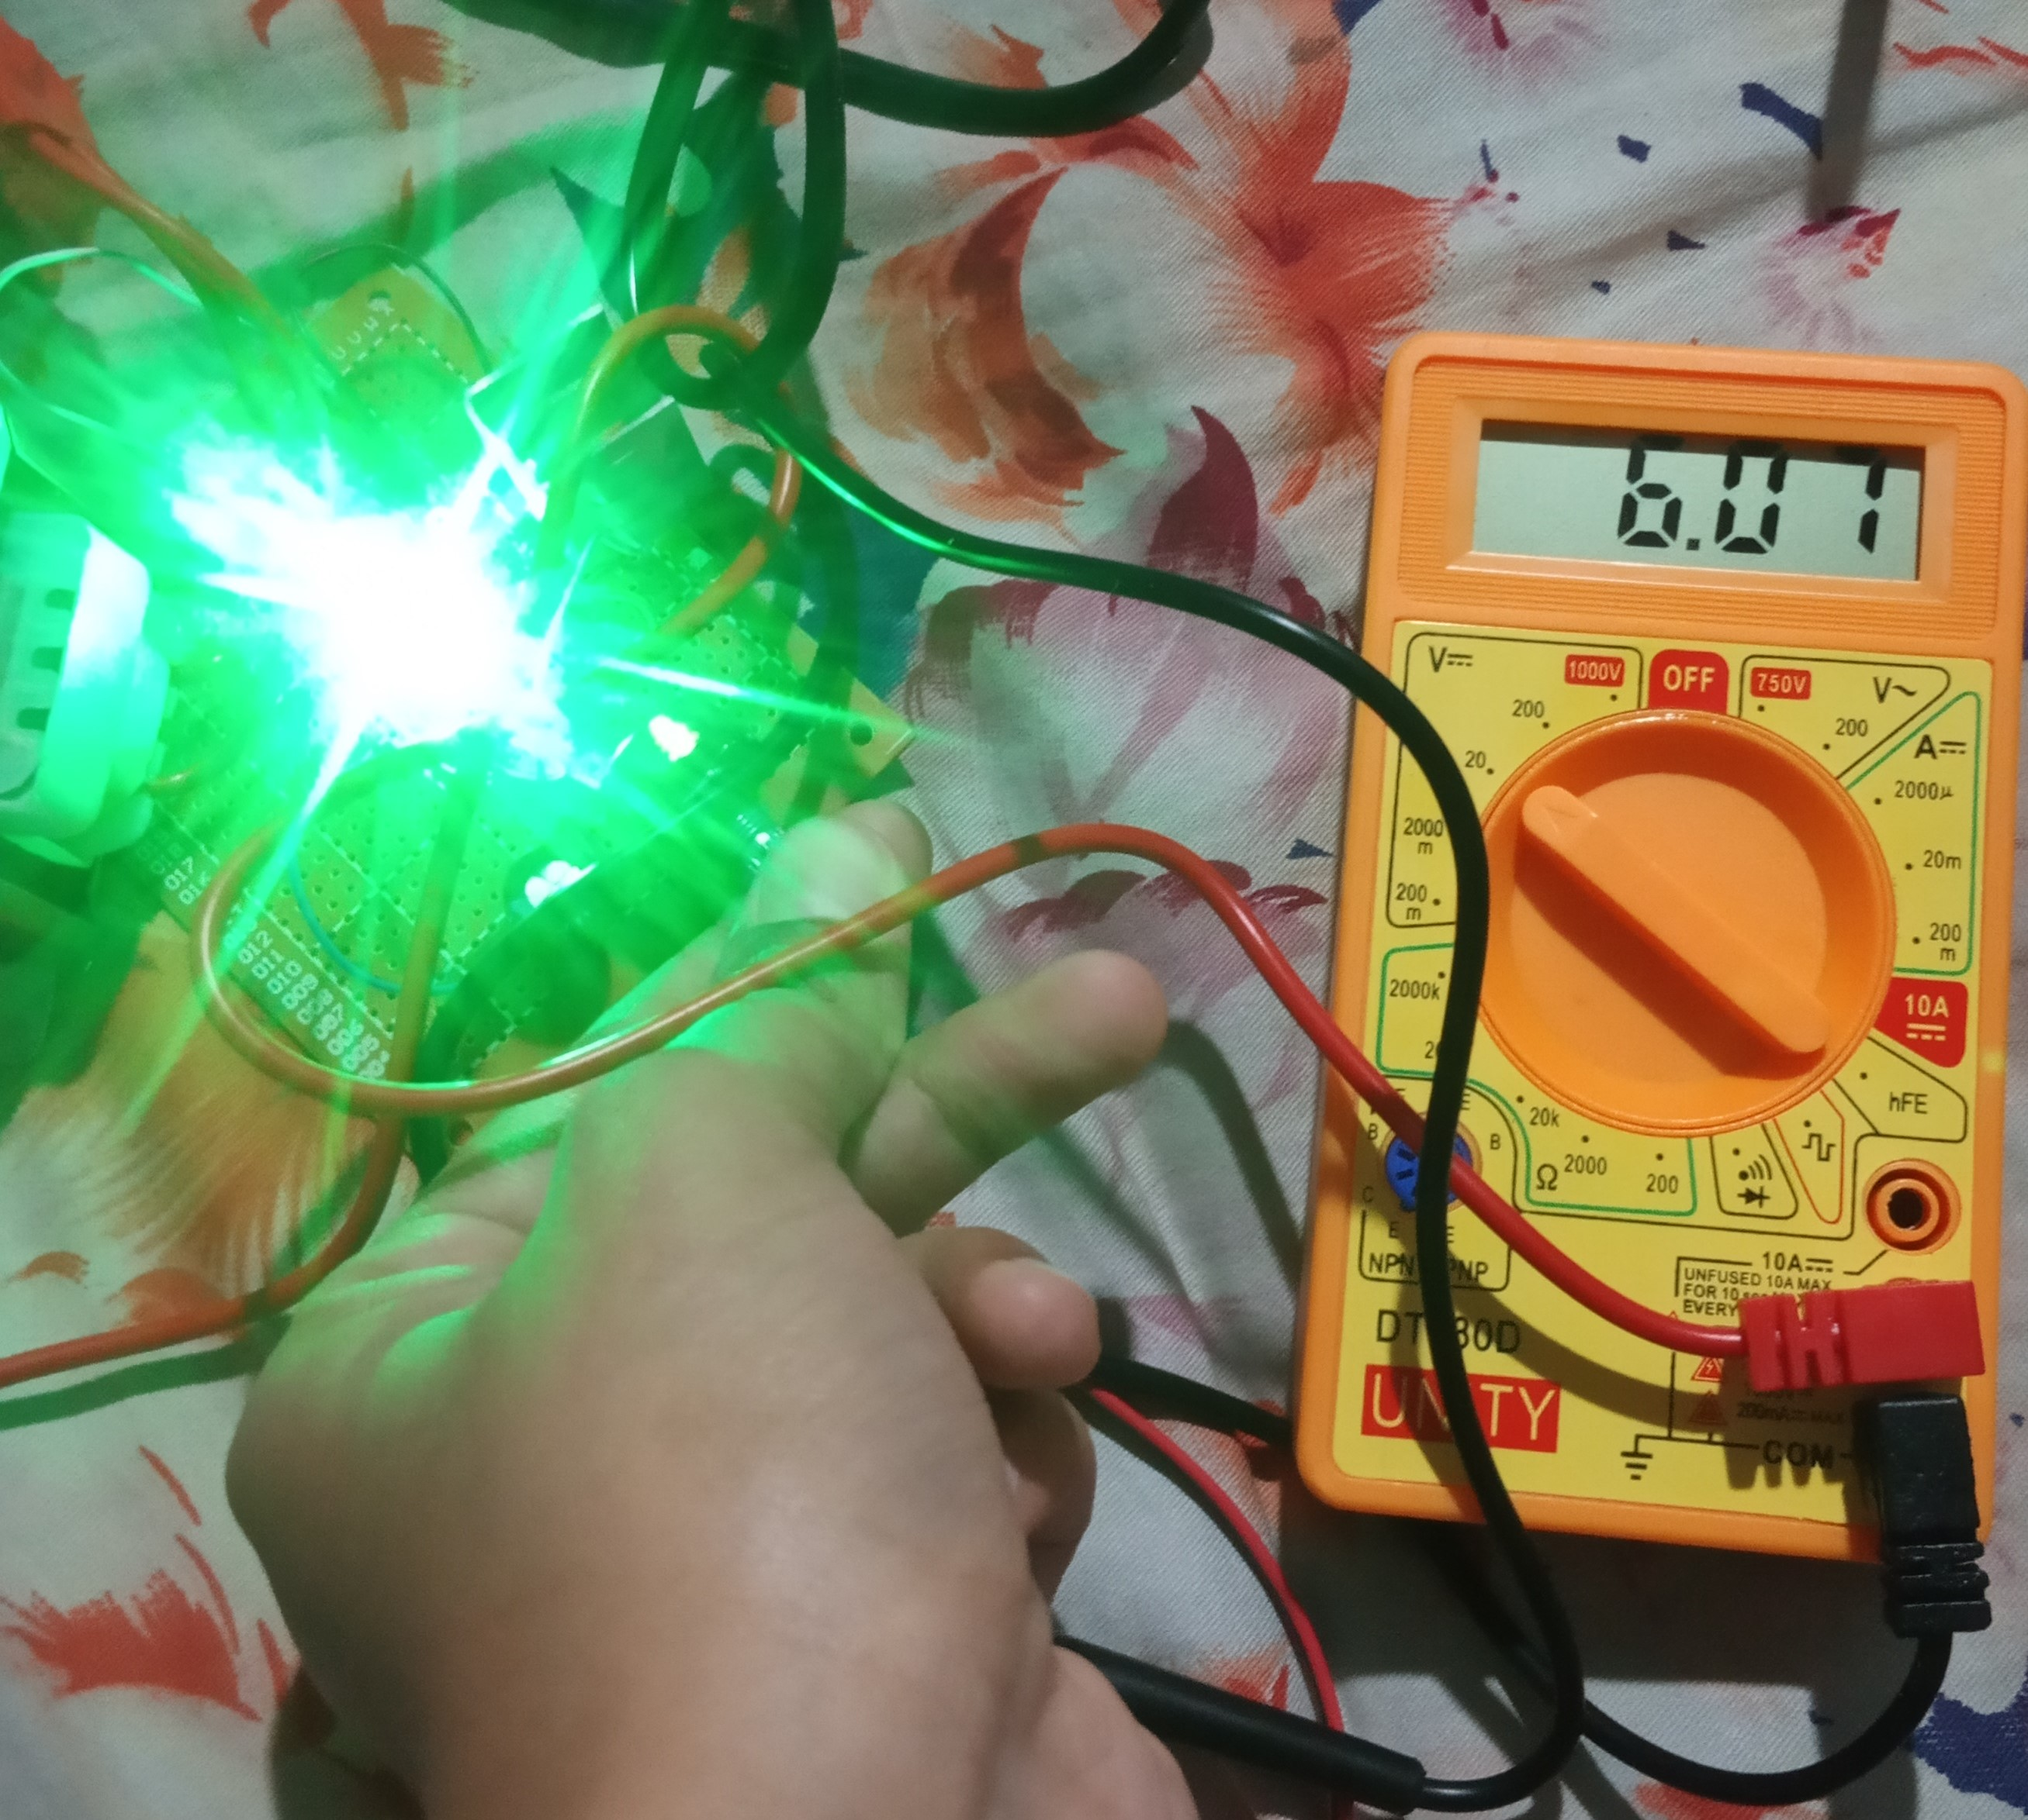
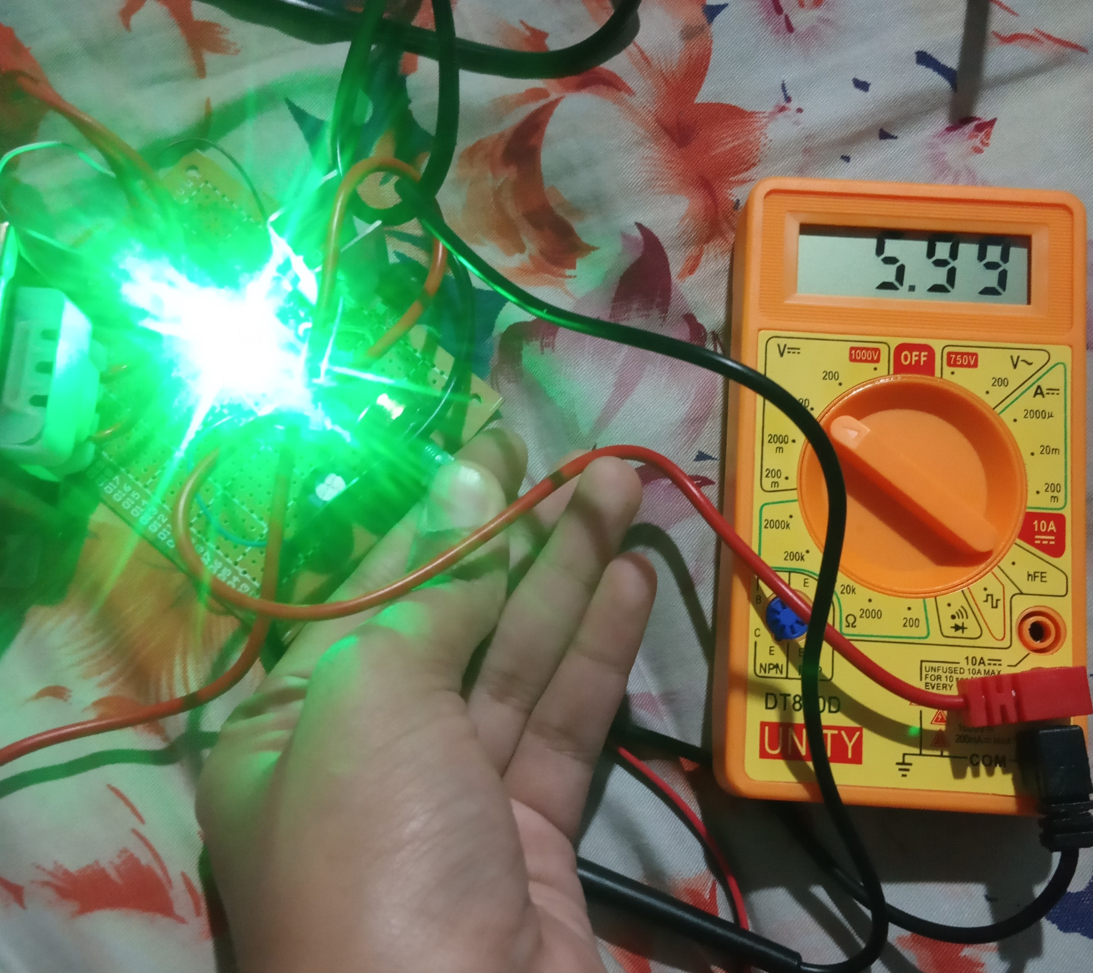
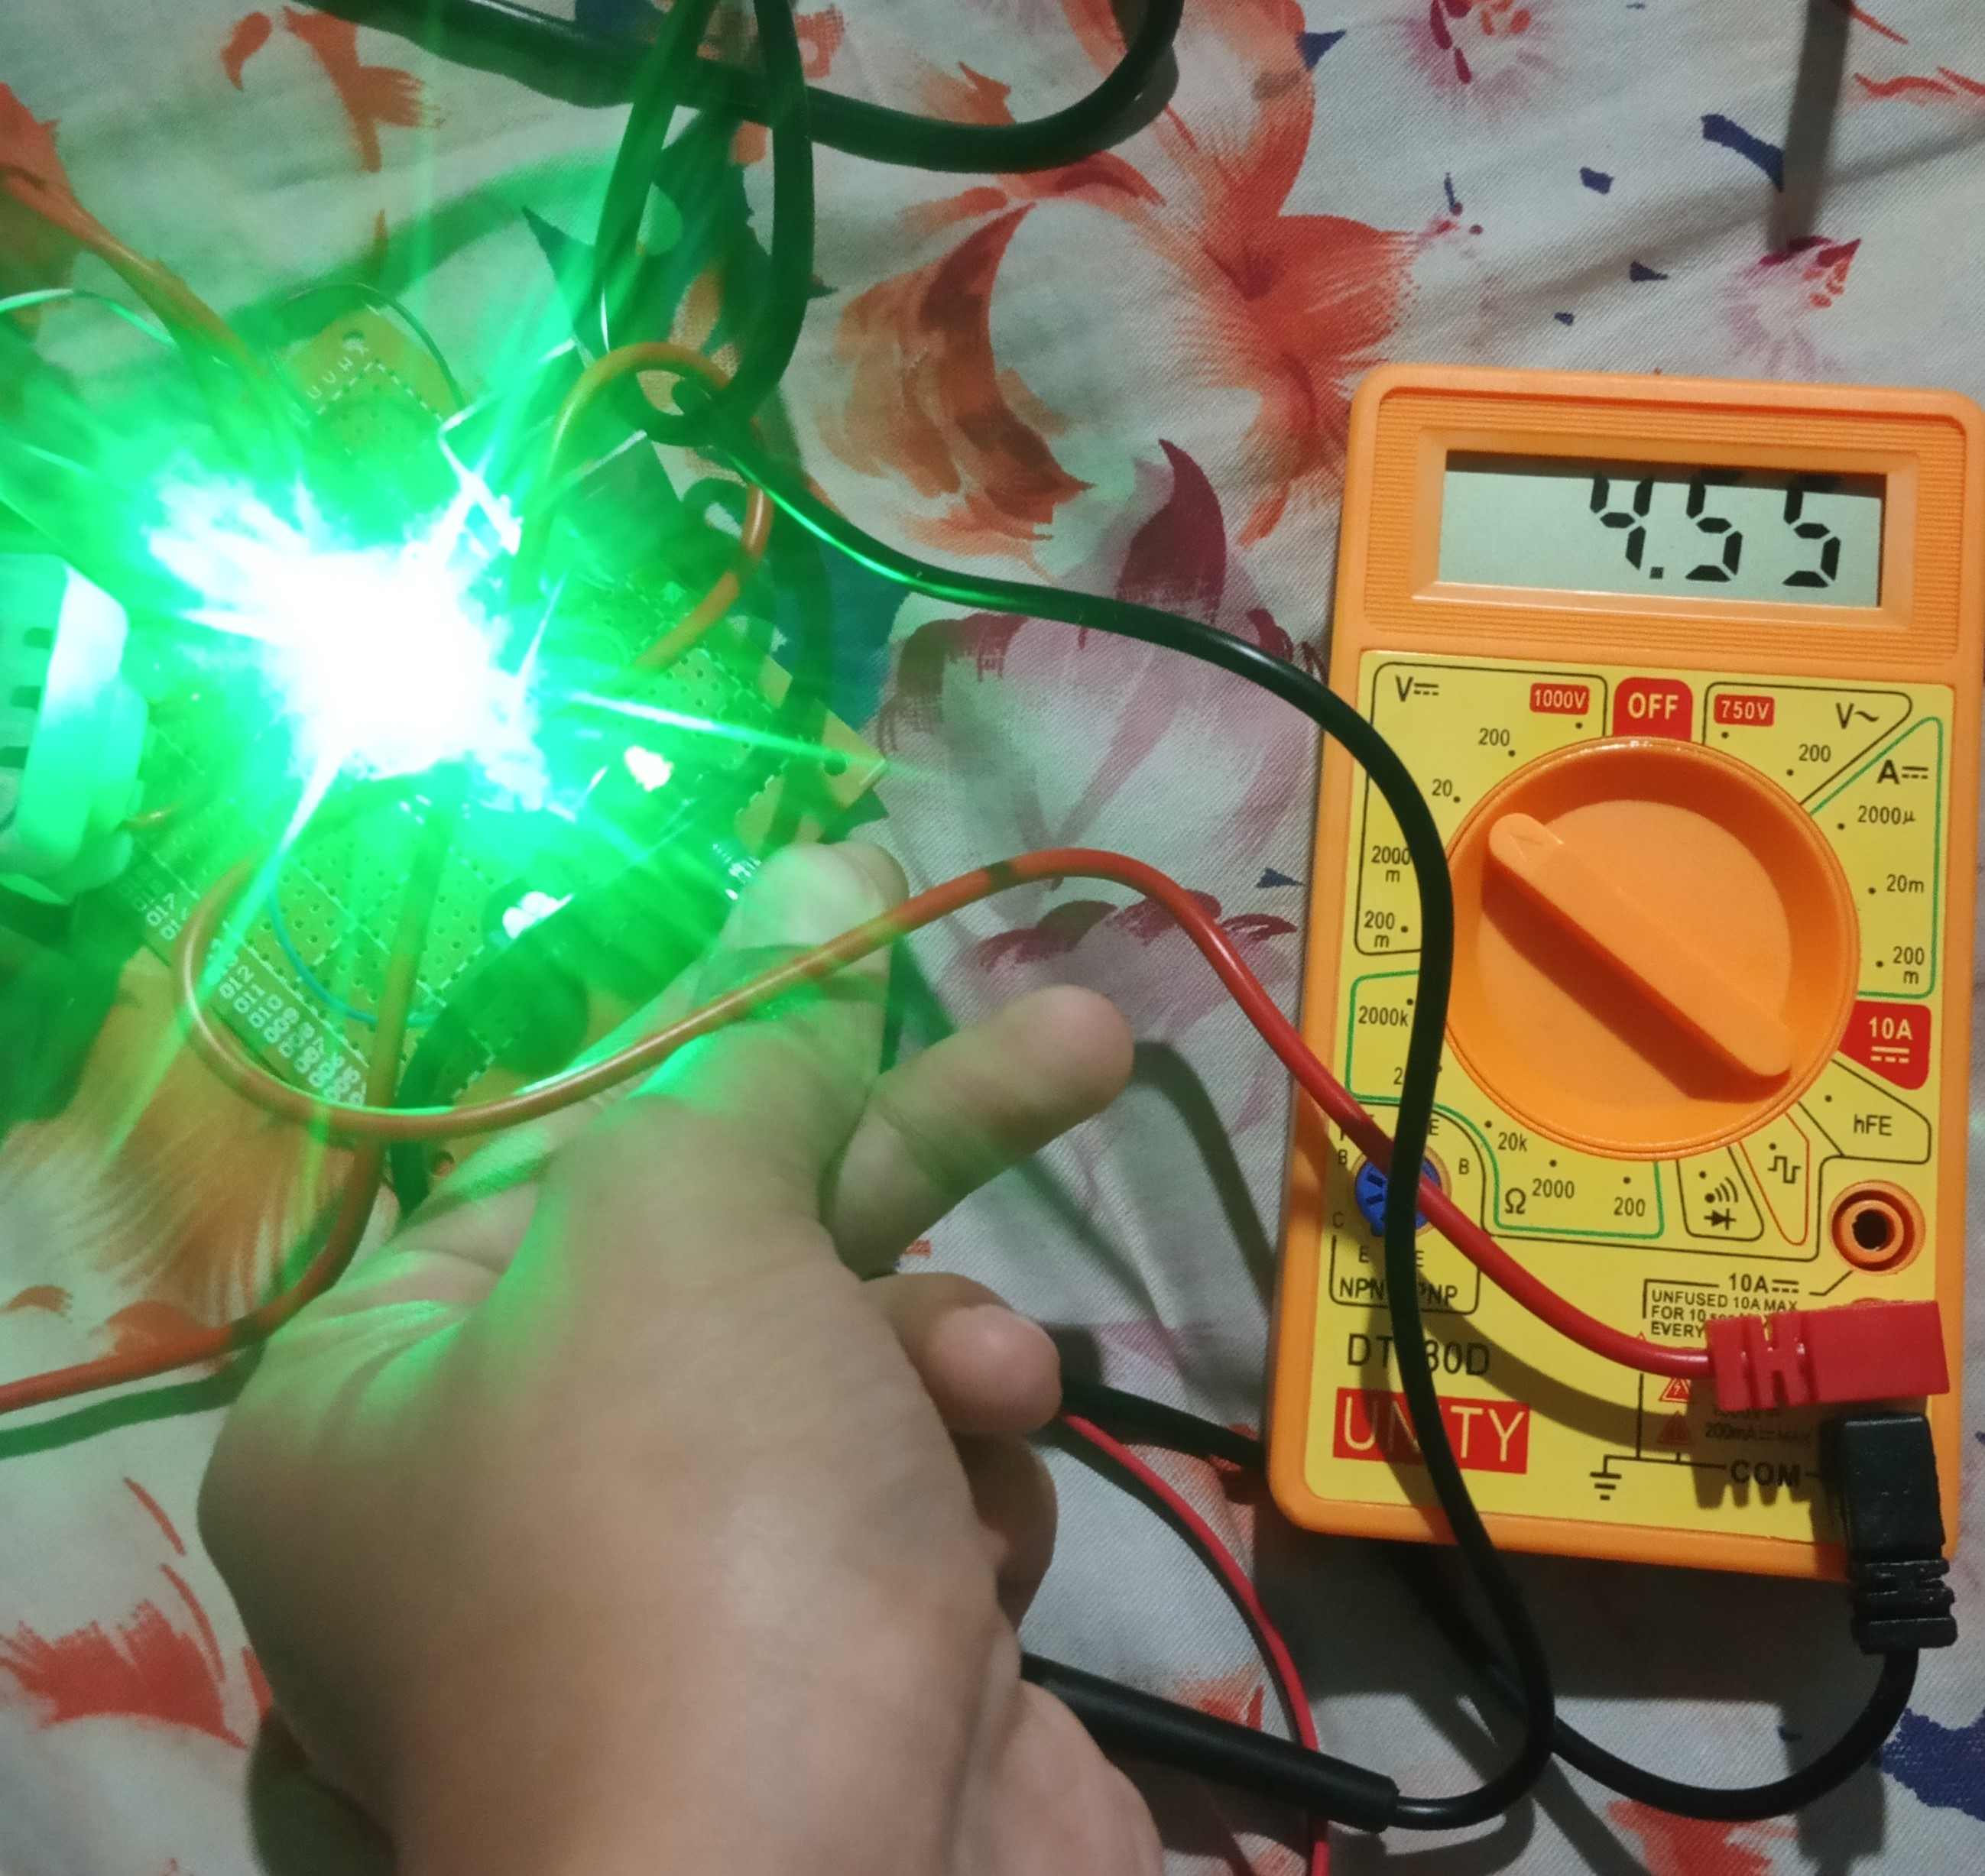
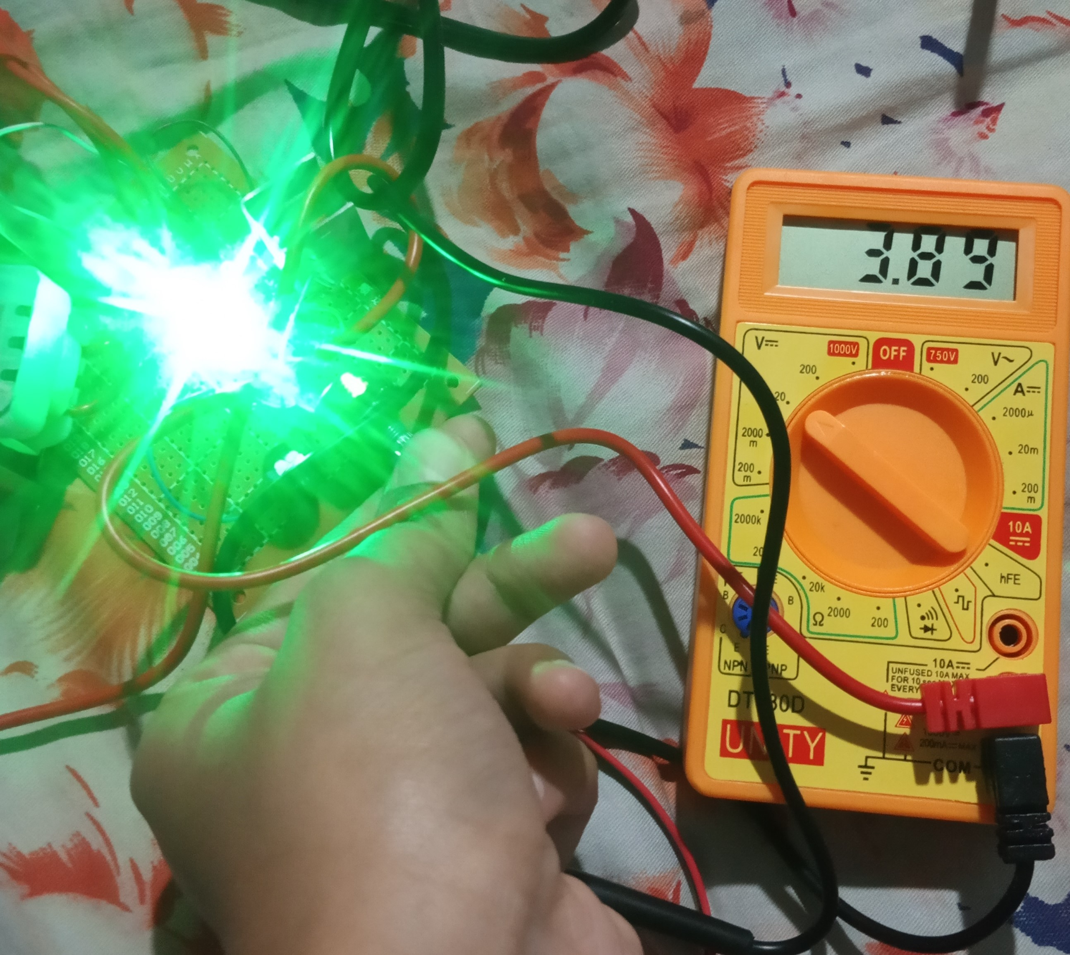
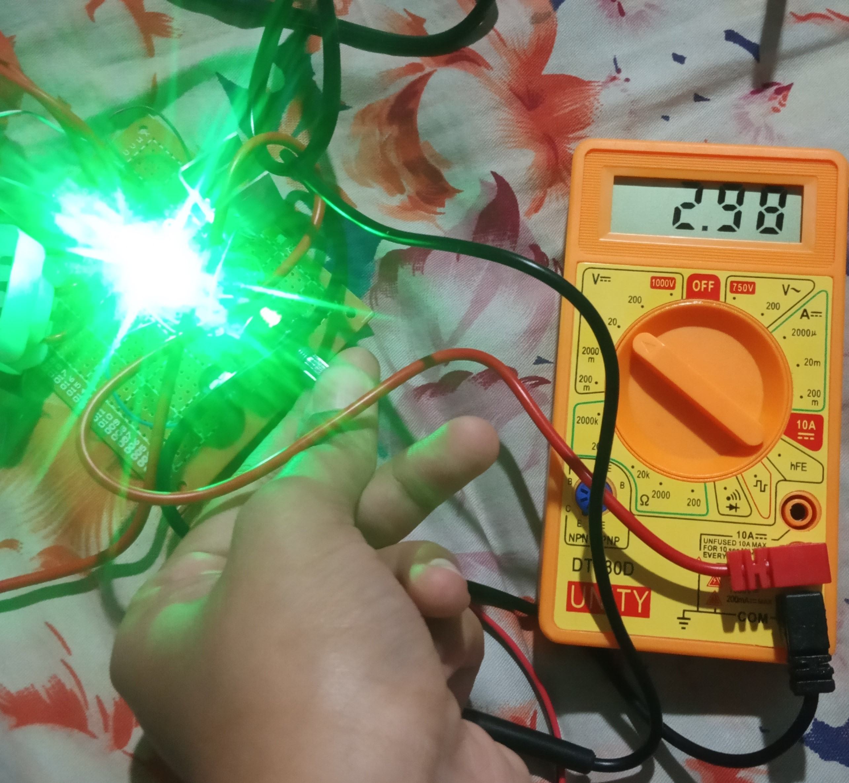
PCB Design and Casing

Slide 16
Now let us show our project

